Slide 1
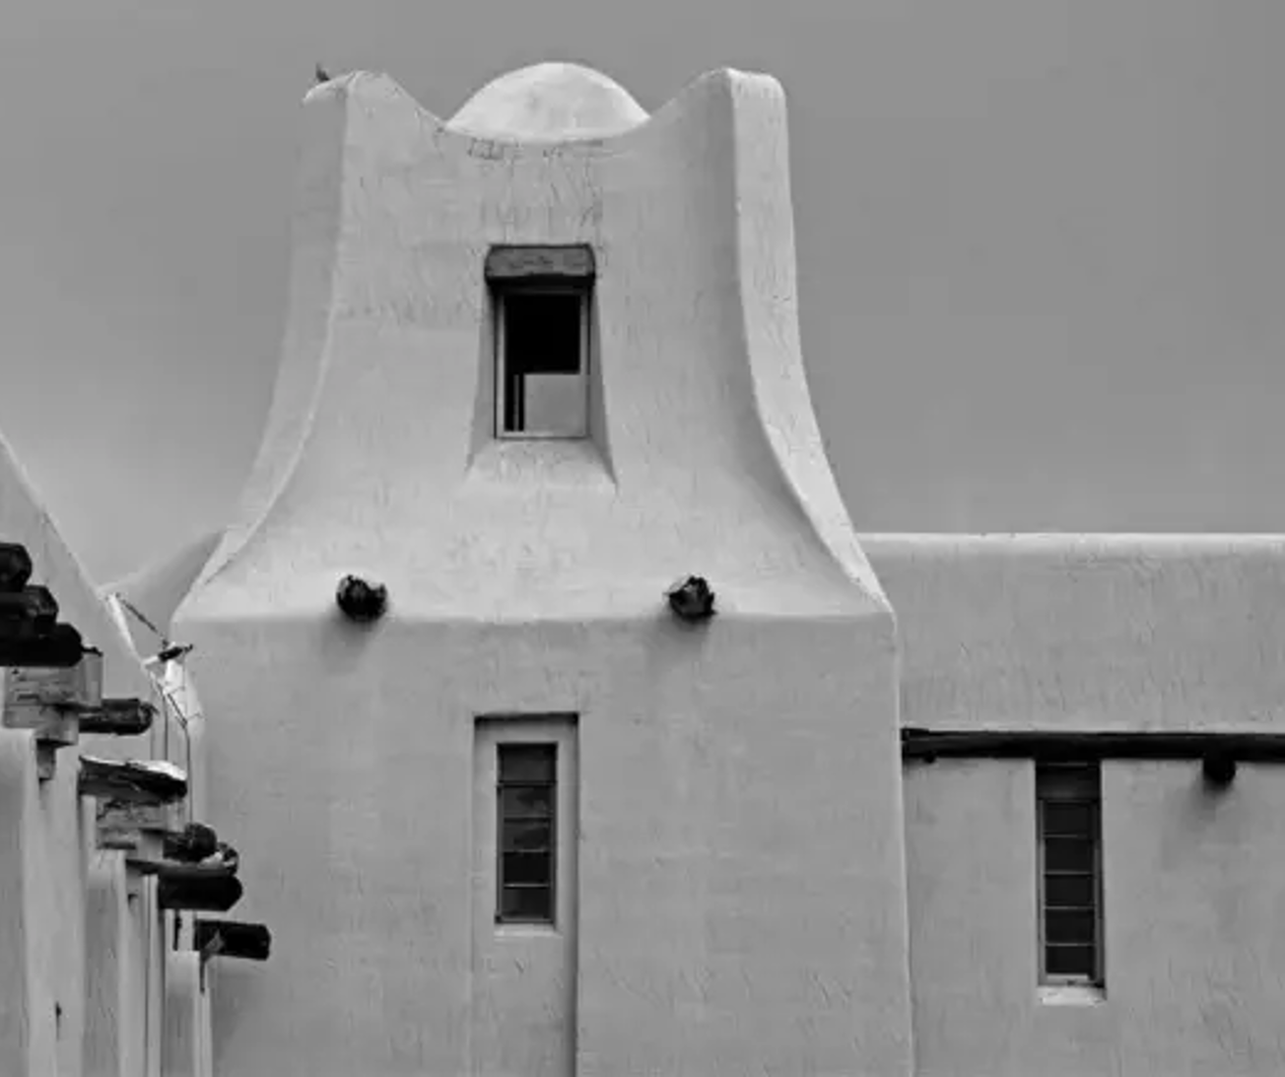

Doña Ana County Treasurer
Investment Report
Prepared by Eric L. Rodriguez
County Treasurer
December 10, 2024
First Quarter
FY 2025

Slide 2
Primary Objectives
Safety: Investments shall be undertaken in a manner that seeks to ensure the preservation of capital in the overall portfolio. The objective will be to mitigate credit risk and interest rate risk.
Liquidity: The investment portfolio shall remain sufficiently liquid to meet all operating requirements that may be reasonably anticipated.
Return: The investment portfolio shall be designed with the objective of attaining a market rate of return throughout budgetary and economic cycles.

Slide 5
Holdings
SUMMARY BY INVESTMENT TYPE
Security Type |  |  | Balance | % of Total | Limits
Money Markets/Savings |  |  | $42,779,050.19 | 21.10% | 60%
Brokered CDs |  |  | $11,500,000.00 | 5.67% | 35%
Federal Home Loan Mortgage Corp (Freddie Mac) |  |  | $21,137,293.75 | 10.43% | 35%
Federal National Mortgage Association (Fannie Mae) |  |  | $11,583,961.10 | 5.71% | 35%
Federal Farm Credit Bank (FFCB) |  |  | $39,898,793.00 | 19.68% | 35%
Federal Agric Mtg Corp (Farmer Mac) |  |  | $99,900.00 | 0.05% | 35%
Federal Home Loan Banks (FHLB) |  |  | $41,724,452.50 | 20.58% | 35%
Tennessee Valley Authority |  |  | $238,658.75 | 0.12% | 35%
Municipal Bonds |  |  | $3,828,082.62 | 1.89% | 35%
U.S. Treasury Bill (T-Bills) |  |  | $2,305,176.11 | 1.14% | 35%
U.S. Treasury Notes (T-Notes) |  |  | $2,930,820.00 | 1.45% | 35%
U.S. Treasury Bonds(T-Bonds) |  |  | $202,185.06 | 0.10% | 35%
Commercial Paper (CP) |  |  | $0.00 | 0.00% | 35%
Supranationals (Sovereign Bonds) |  |  | $0.00 | 0.00% | 15%
Local Banks |  |  | $20,758,908.58 | 10.24% | 60%
Other |  |  | $3,715,000.00 | 1.83% | 10%
Total |  |  | $202,702,281.66 | 100%

Slide 6
Maturity Distribution

Slide 7
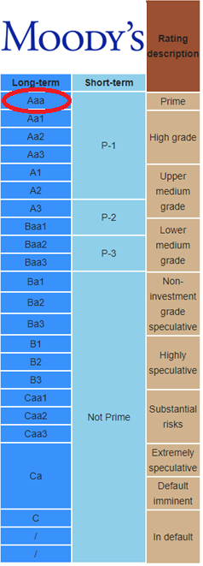
Credit Quality

Slide 8
Total Earnings Trend

Slide 9
5 Year Monthly Earnings Comparison

Slide 10
Investment Policy Compliance

Slide 11
Moving Forward
Strategy
Continue to take advantage of recent rate increases. Focus on laddered portfolio.
Manage and forecast cash flows to maximize on long term holdings
Secure long calls or bullet holdings
Increase Brokered CD holdings which carry minimal risk and have good spreads
Economic Factors to Consider
Two recent rate cuts in September and November. +70% probability for rate cut in December
Current CPI Rate: 2.6% ; Fed target 2%.
Economic uncertainty around Trade, Tariffs, Immigration Policy, Fiscal Policy, Monetary Policy, and Inflation.

Slide 12
Performance Overview of Treasurer’s Term
Total Income During Term:
$19,538,812.26

