Slide 1
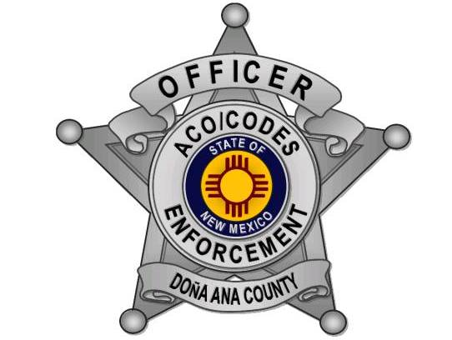
Illegal dumping Community outreach Partnerships A.C.E.S. Projects
Notes:
Good afternoon, I’m Mary Lou Ward I’m the supervisor for DAC ACO/Codes Enforcement.
Today I’m going to talk to you about our role in the illegal dumping partnership and how we have used our this to assist us with helping the community.

Slide 2
A.C.E.S.
Animal Control and Code Enforcement Environmental Survey
Each project conducted in a community involves several agencies:
Animal Control Officers
Code Enforcement Officers
Planning and Zoning (Community Development)
Animal Services Center of the Mesilla Valley
Coalition for Pets and People
South Central Solid Waste Authority
Notes:
Because Illegal Dumping is a problem for everyone, we have joined partnerships.
Because of the partnerships it has given us more resources and opportunities which affords us more ways to give back to our communities.
Today I would like to start with our ACES program.
ACES stands for Animal Control /Codes Enforcement Enviromental Survey.
ACES projects are conducted in our communities every month and involves several agencies.
Read bullet points….
You can see that we not only covers the codes part of it but it also goes over ACO’s since our office does both.

Slide 3

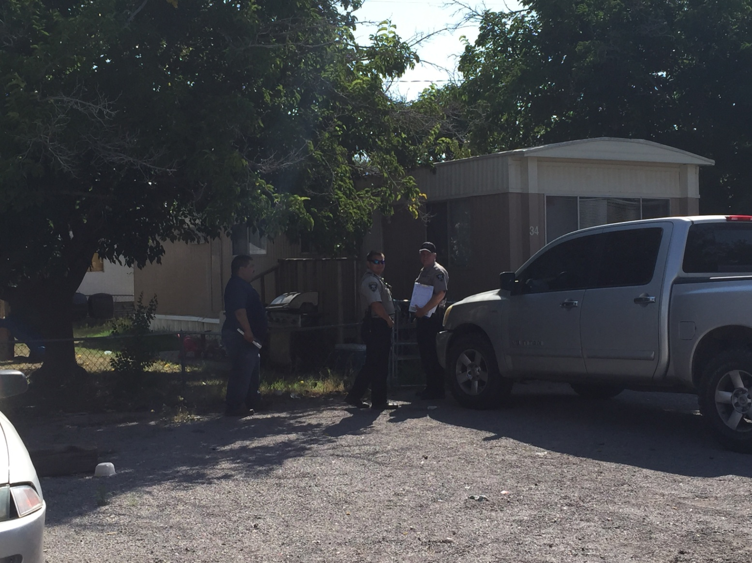
Purpose of the projects
Improve our communities
Getting voluntary compliance
Encourage pride and leadership
Develop partnerships
Offer resources
Educate the community
Reduction in illegal dumping
Bite prevention
Animal Husbandry
Notes:
Now that you know what ACES is…..let me tell you the purpose of this project.
The purpose of the projects are to improve our communities through education rather than citations.
By getting voluntary compliance for counties ordinances and our State Laws.
To encourage pride and leadership; with volunteers in each community.
To develop a strong and lasting partnership with DAC, each community and other agencies.
To offer a resource for clean-up efforts and animal related issues rural areas face.
To go into the local schools and educate the kids on illegal dumping, recycling, bite prevention and animal husbandry
By doing all of this we are seeing less illegal dump sites and less homes with less violations.

Slide 4
How do we do this?
Community grid areas are selected
Community leaders are informed
Area schools are visited
Communities are given notice
Notes:
So how do we do this???????
First the officers select an area in each community they believe has the most violations and set up a grid area.
They inform our commissioners and community leaders of each event.
If available you can set out Posters and banners in various locations when possible through out our community to alert everyone about the up coming ACES and dumpster days.
Articles are placed in the newspaper and notice is given to the surrounding media events.
Officers also go into the local elementary schools when possible and educate 3rd and 4th graders on illegal dumping, recycling and animal related issues.
This is done prior to the ACES projects.

Slide 5
Door to door
Address violations and educate
One and a half weeks before a dumpster day is set up (clean up with Carlos Day)
Allows for compliance
Notes:
Once this is all done then we go door to door addressing any violations seen and educate the residents on everything from codes violations, animal issues to p&z violations.
The goal is to have each project be conducted at least 1 ½ to two weeks before a dumpster day clean-up.
The allows the citizens to come into compliance by offering them a solution to their problems and they now know the laws.

Slide 6
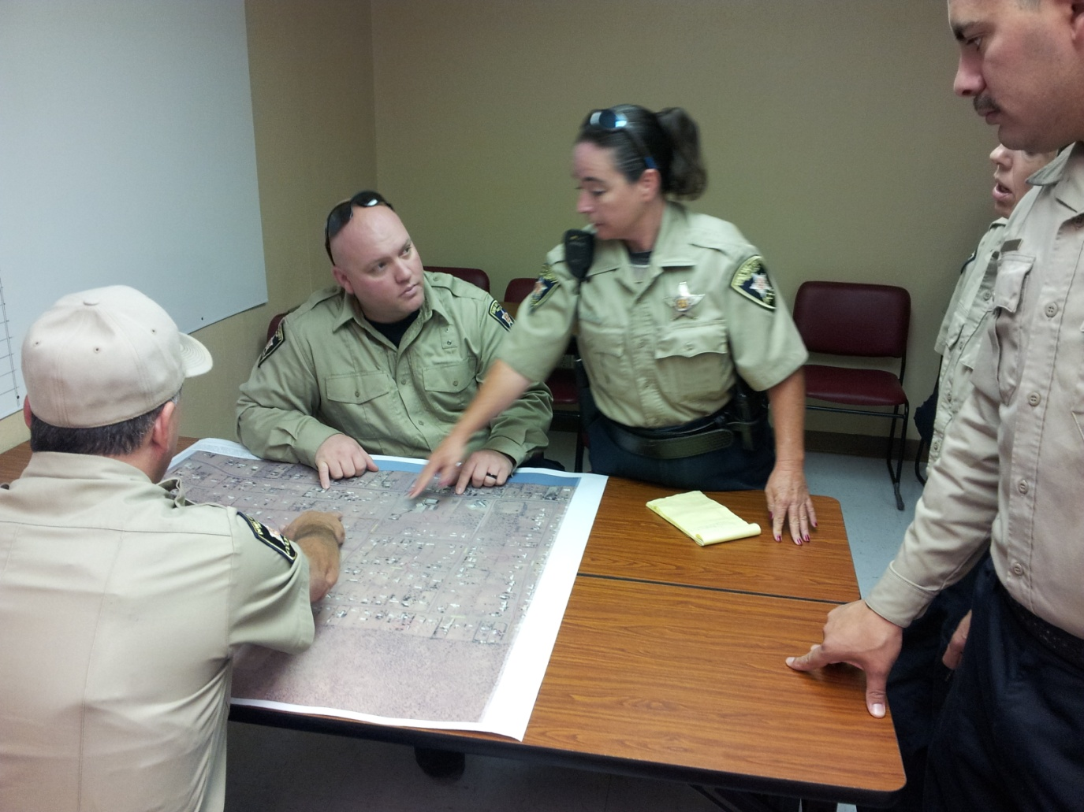
Our A.C.E.S Projects started in April of 2013 and has continued every month, with a projected calendar into June 2019.
Notes:
Read slide……….

Slide 7
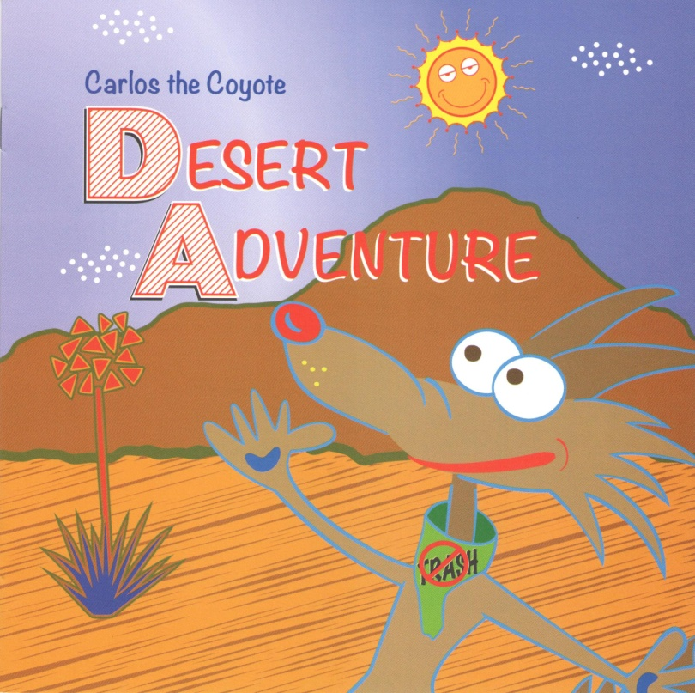
The first illegal dumping educational book was created
Carlos the Coyote Desert Adventure
Carlos the Coyote came on board to
help us educate the children and adults in
the communities and schools.
He came to us with his local friends:
Sara Snake
Johnny Jackrabbit
Lizzie Lizard
15,000 Books to educate kids!
Notes:
New to the team was Carlos the Coyote who was created by our department to assist our officers in schools and community events.
Read slide…………..
During this year we ordered and printed 15,000 books to hand out to the kids along with the pledge sticker.
The kids take the illegal dumping pledge….
“I pledge to do my part to put trash in its place and report illegal dumpers and trash sites”. “How”? “By calling 877 NO THROW”.
877-668-4769.
Once they have taken the pledge they then get their book.

Slide 8

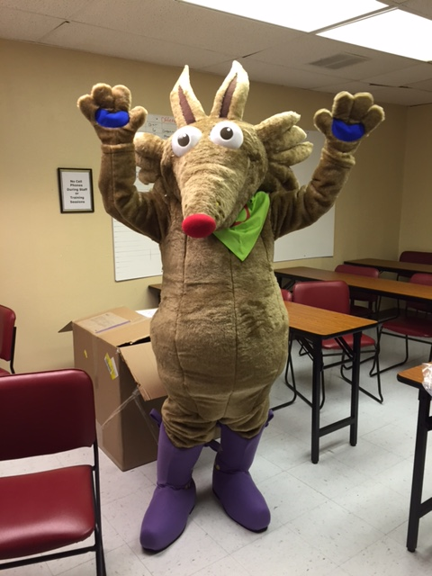
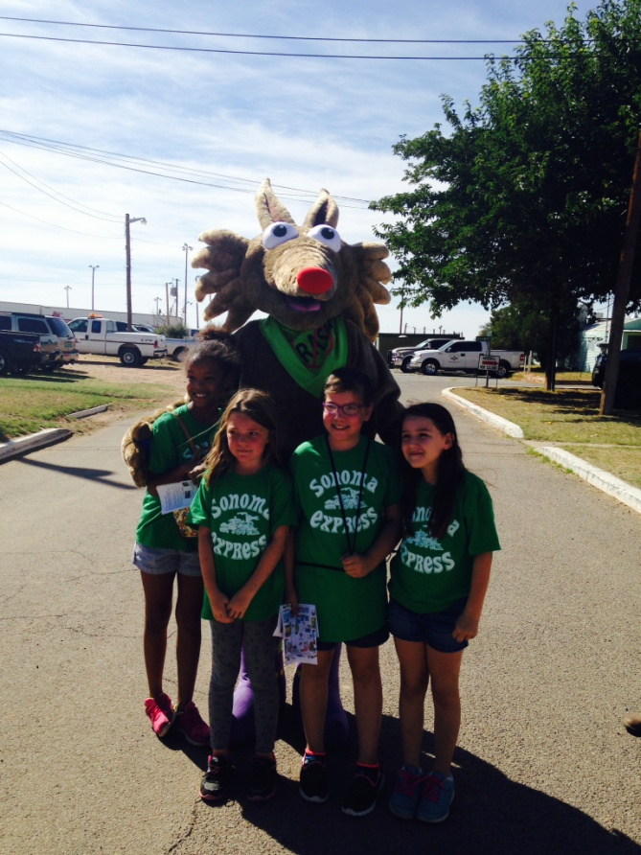
Carlos has come to life
Notes:
Once that was complete Carlos came to life……….
Read slide…………….

Slide 9
Getting creative
We teamed up with NMSU and had three 15 second animations created that were played in the local movie theatres reminding the community to stop and report illegal dumping.
Notes:
Before I play these videos today I would like to introduce to you Carlos the Coyote and Lizzy the Lizard.
Video #1 is the horror scene
Video #2 is the Romance scene
Video #3 is the Western scene

Slide 10

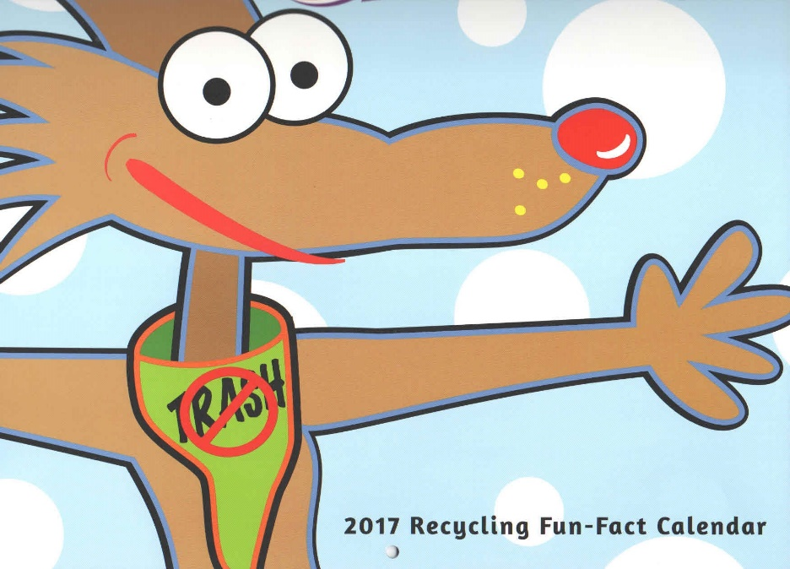
2017 recycling fun fact calendar
In 2017 5,000 recycling fun fact calendars were created and given to the children of Dona Ana County to assist Carlos and the Codes Officers in the schools to help educate the kids on recycling.
Notes:
Thanks to a grant we had:
Read slide:
Then…………..
Carlos the Coyote animation (a 30 second animation has been running in the movie theaters to remind everyone about illegal dumping).

Slide 11
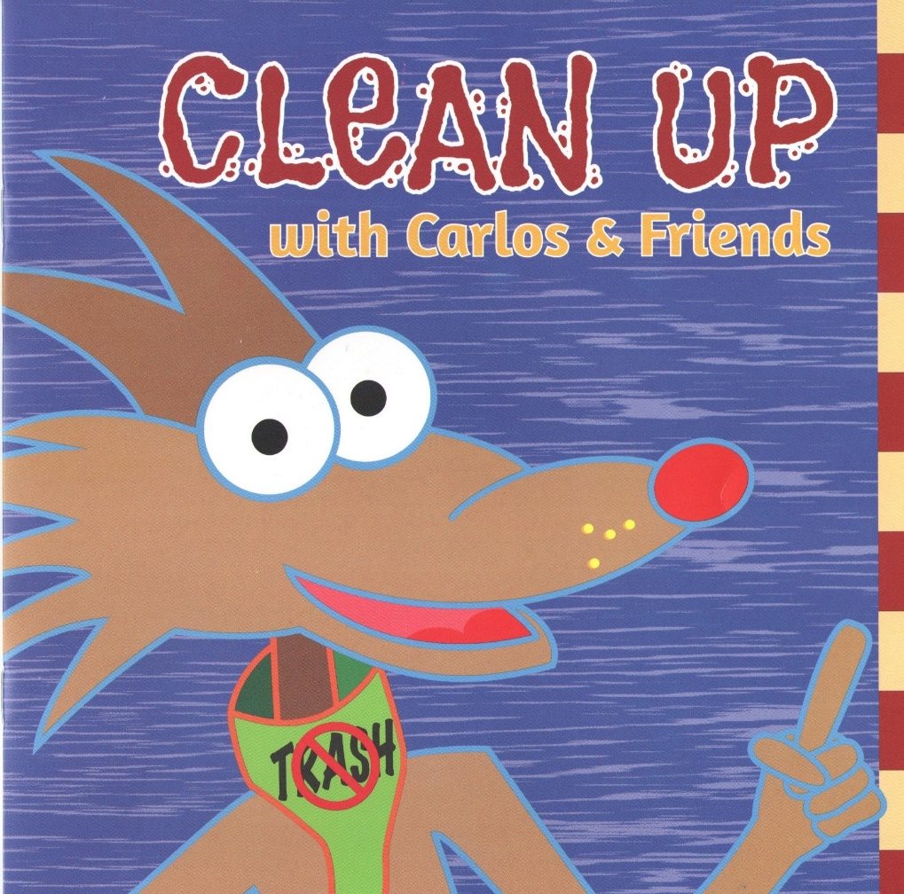
The second illegal dumping and recycling educational book
Carlos and Friends
Continues to help us educate the children about illegal dumping and this time he wanted to add recycling tips.
15,000 books were printed
Notes:
Again thanks to the grant we ordered another 15,000 copies of a second new book titled Clean-up with Carlos and Friends in English and in Spanish.

Slide 12
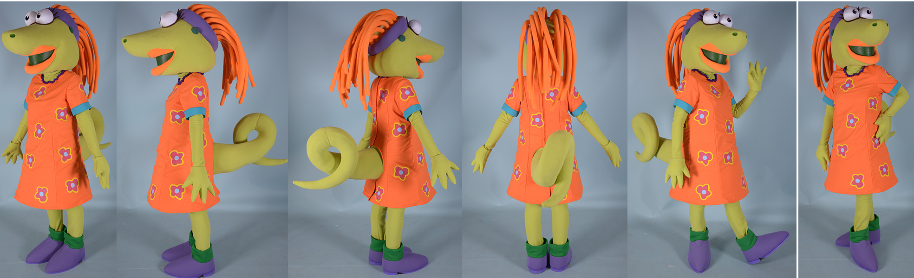
Lizzy the lizard joined Carlos in coming to life
Straight out of the book
Notes:
And now Lizzy the Lizard has joined Carlos in the educational campaign to assist the officers at special events and schools.

Slide 13
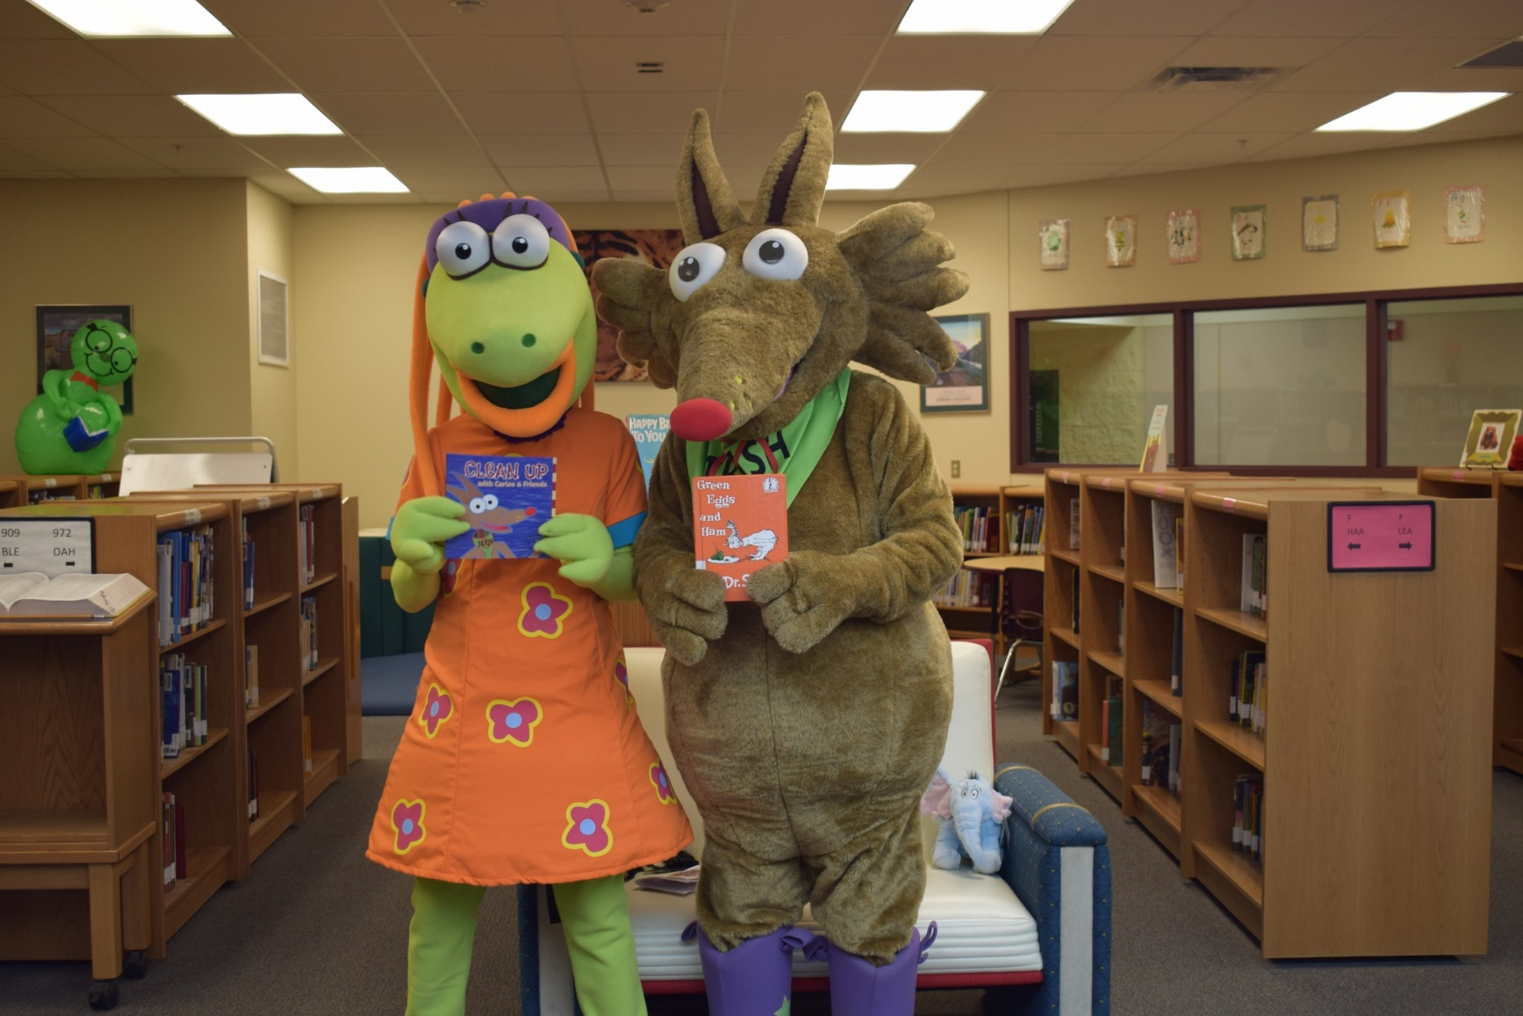
Lizzy now helps Carlos in schools and special events to educate the children and adults on illegal dumping, and recycling.
Notes:
Here Lizzy and Carlos have joined other partnership's like the READ across America program and assisted the officers who sat for a reading.
Notice one of the books they used for the reading!

Slide 14

New 30 second animation is released
Notes:
Once again we teamed up with NMSU for a 4th animation but this time it was for 30 seconds to continue with the anti- illegal dumping campaign message.
Then recently this year Carlos got his own website:
CleanupWithCarlos.org so please if you have a chance to visit the site that would be great.
Play the new video here

Slide 15
Measurement of Success
East Mesa 24% Increase in compliance
Chaparral 22.3% Increase in compliance
Rincon 32.2% Increase in compliance
Anthony 0.0% stayed the same
Tortugas 21.4% Increase in compliance
Bamert 18.3% Increase in compliance

Slide 16

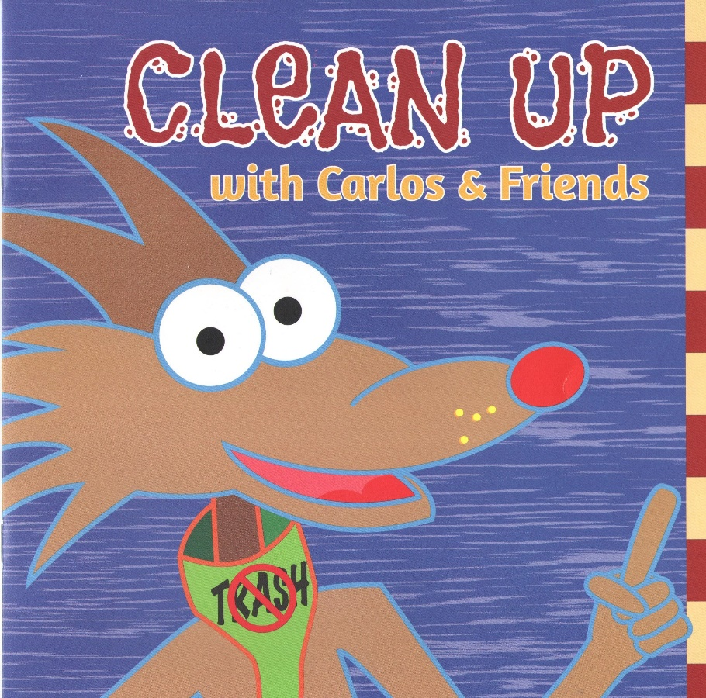
Clean-up with Carlos Days
East Mesa- 4.19 tons
Chaparral- 6.79 tons
Rincon- 4.69 tons
Anthony- 12.08 tons
Tortugas- 11.08 tons
Bamert- 4.91 tons
Total of 43.74 tons of trash
Notes:
Read the slide stats!

Slide 17
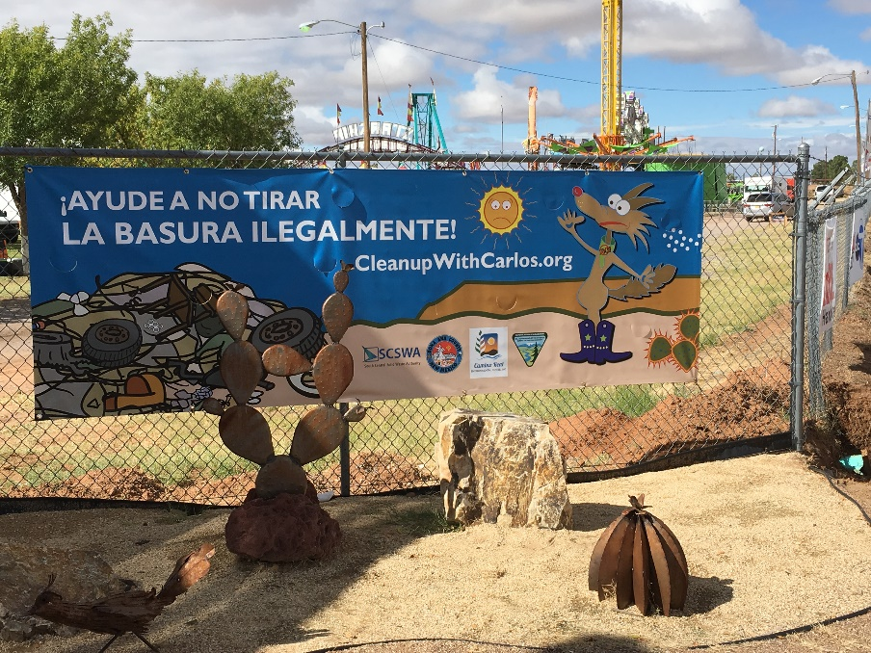
Projects Hours
Total hours A.C.E.S- 670 Hours
Clean-up with Carlos – 144 Hours
Total Hours are 814
Notes:
Read the slide stats!

Slide 18
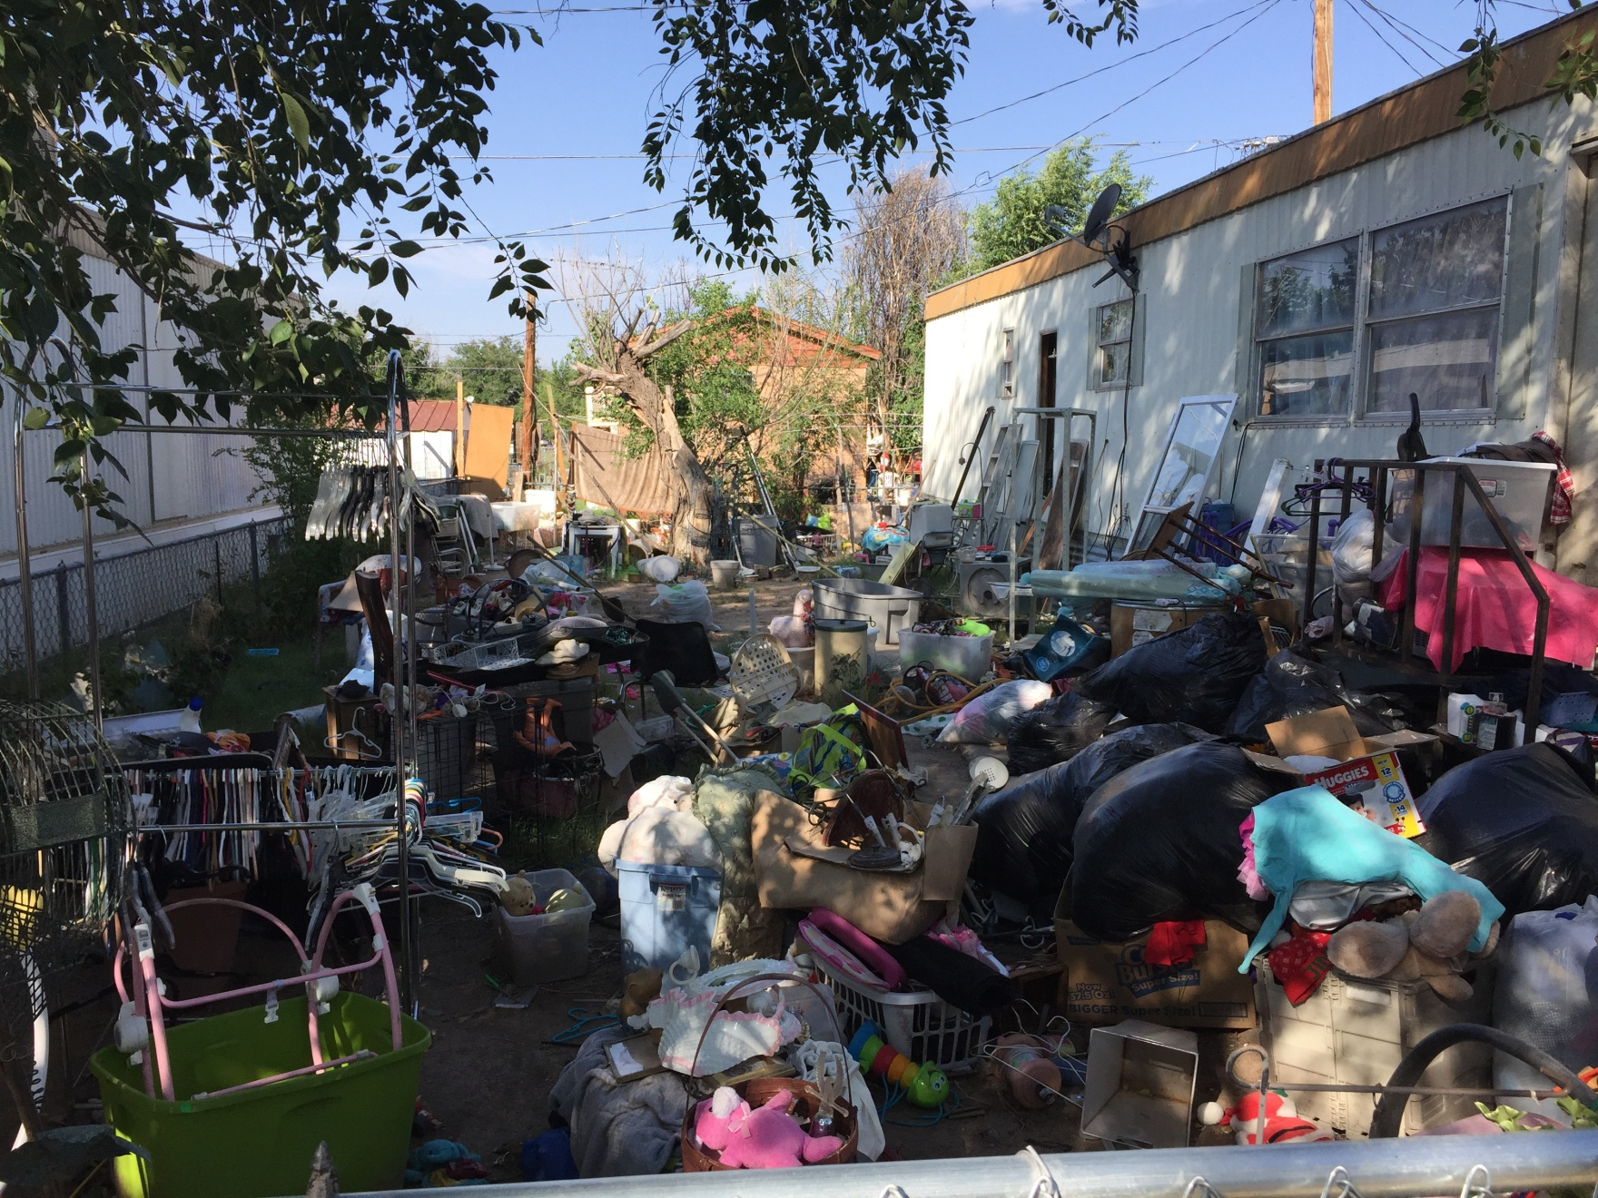
A.
C.
E.
S.
P
R
O
J
E
C
T
T
R
A
S
H

Slide 19
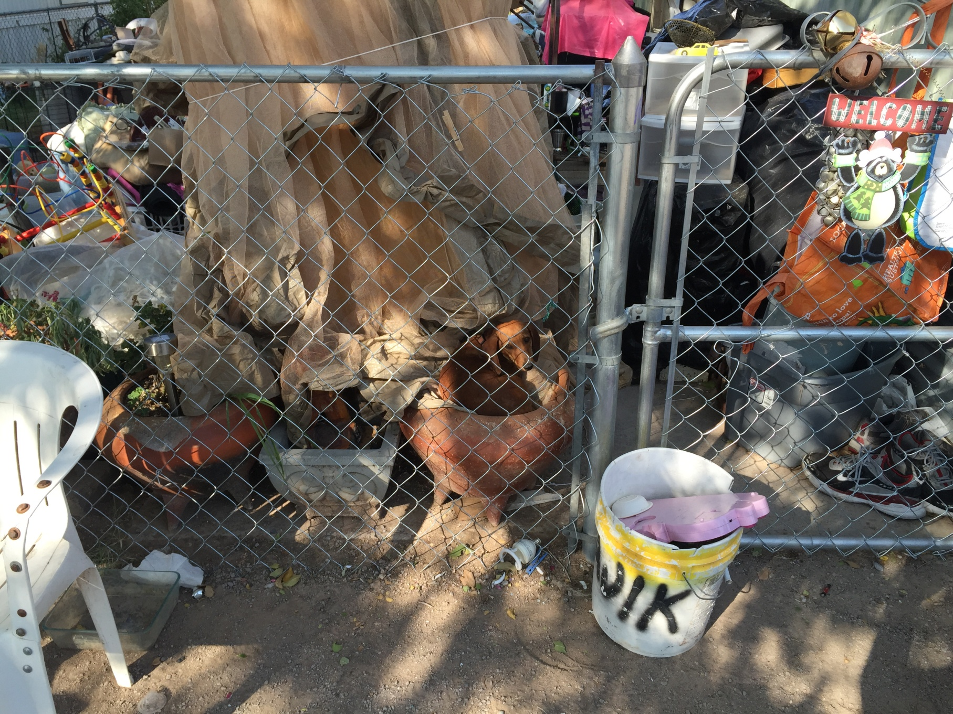
Where’s the dog?
A.
C.
E.
S.
P
R
O
J
E
C
T
T
R
A
S
H

Slide 20
Dona Ana County is approximately 3,851 Square Miles
Making this project a success is possible with the cooperation and the resources available by partnerships and grants

Slide 21
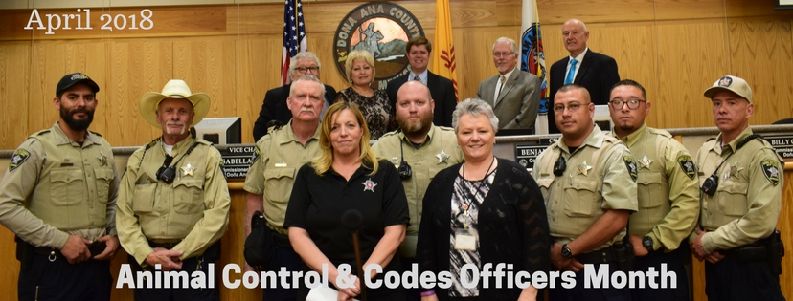
Thank you

