Slide 1

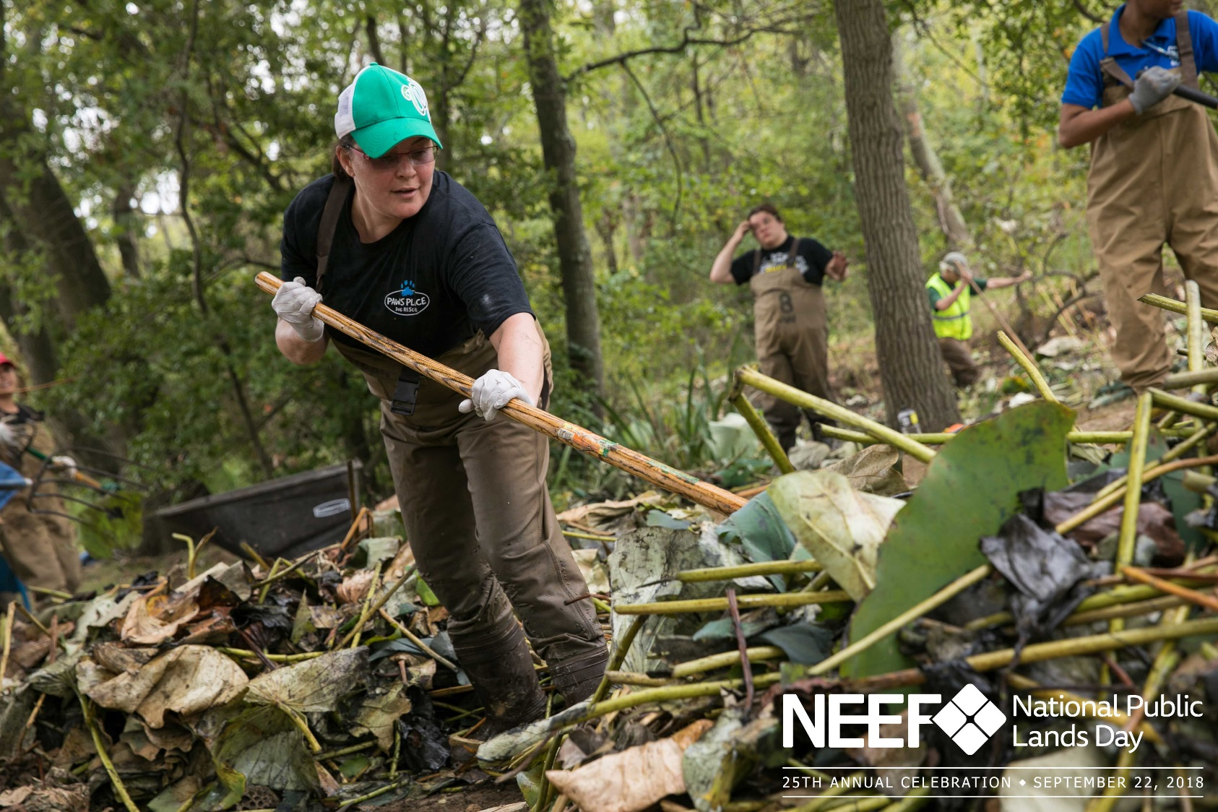
October 24, 2018
Boots on the Ground: Illegal Dumping Partnership Conference

Slide 2
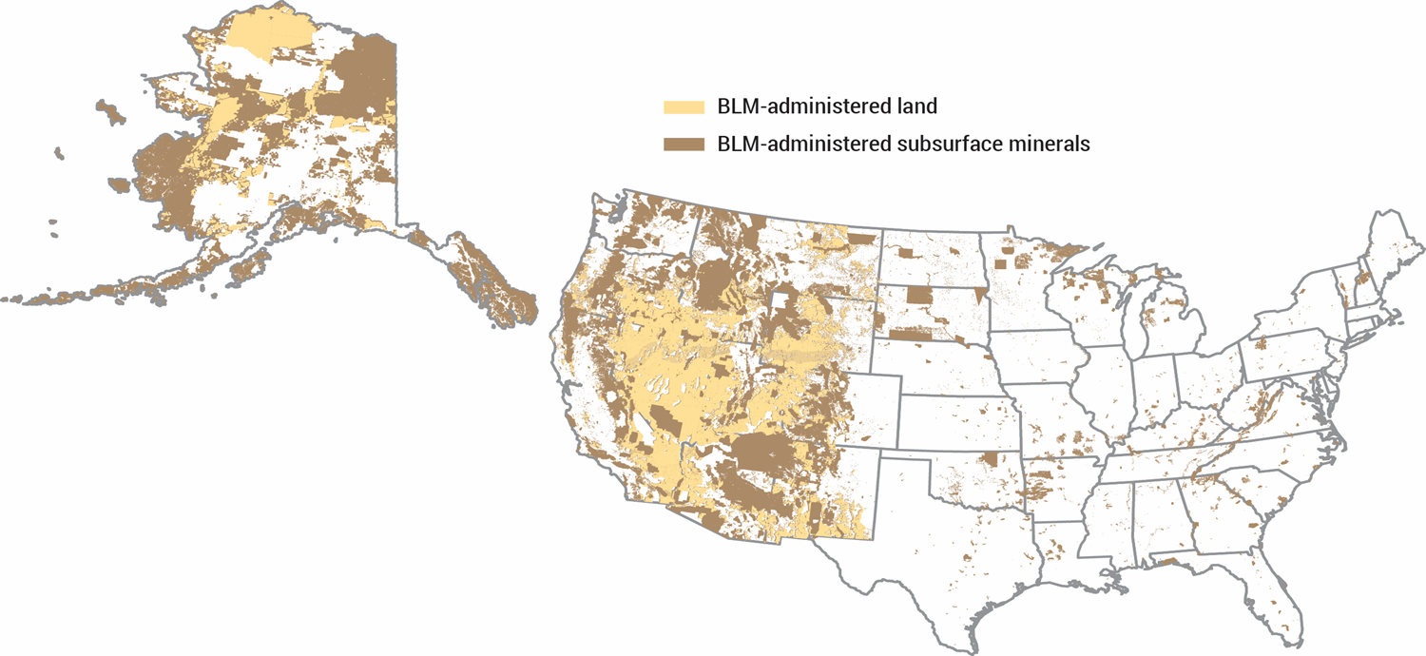
BLM –Rio Puerco Field Office
The BLM manages 1 in every 10 acres of land in the United States

Slide 3
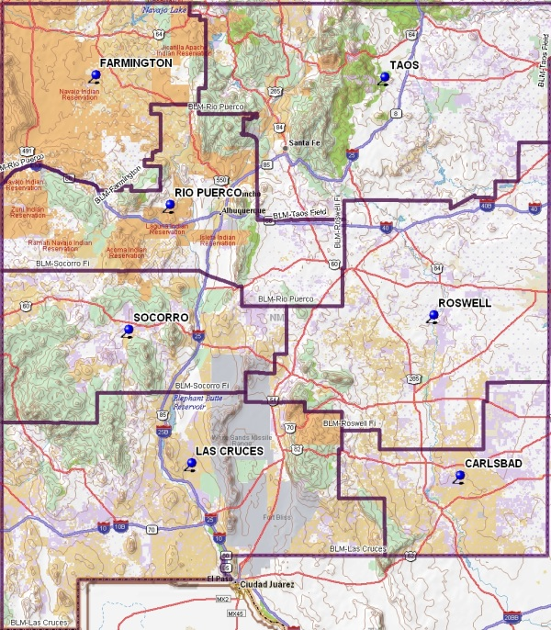
BLM –Rio Puerco Field Office
The agency's mission is to sustain the health, diversity, and productivity of America's public lands for the use and enjoyment of present and future generations.
Notes:
1 Million acres of public land and 3.6 million of Federal Mineral Estate

Slide 4
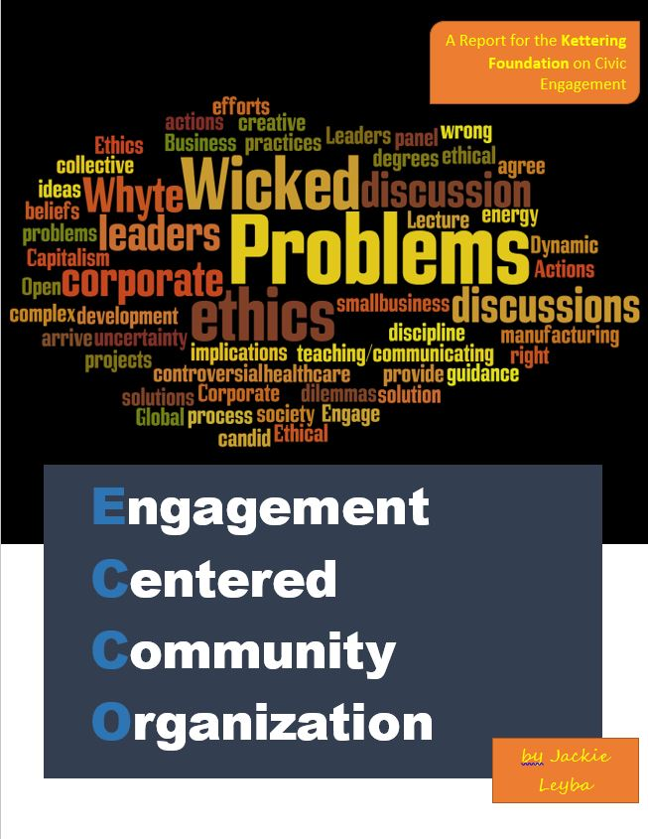
ECCO in the RPFO
Creating and Maintaining Effective Partnerships
A Story of Success

Slide 5
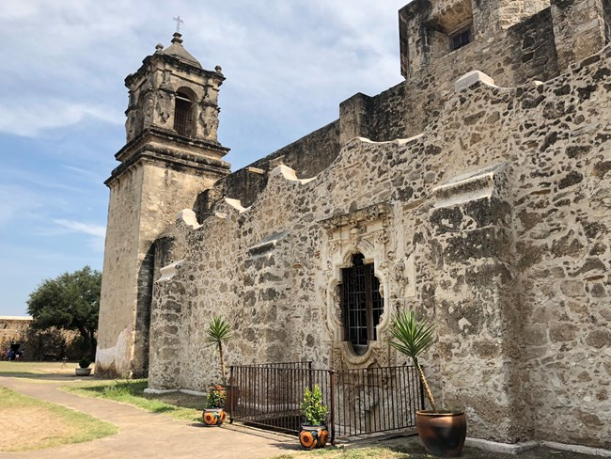
Lessons Learned
San Antonio Missions National Historic Park
Notes:
“Hello, I’m form the government and I’m here to help” is a phrase that in more or less words has been used with both good and ill intentions to attempt to solve wicked and not so wicked problems in the United States for a very long time. From government intervention in how citizens save for retirement and unemployment through the Social Security Act of 1935 to a current example that I would like to share.

Slide 6
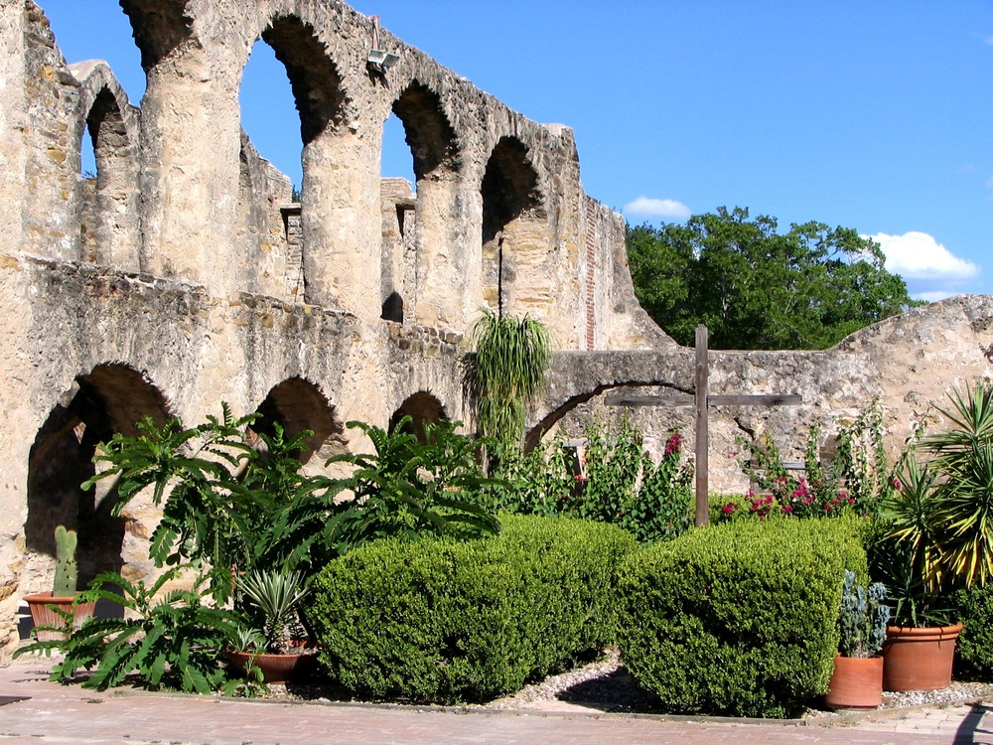
Lessons Learned
San Jose Convento
Impoverished Community
Lack of healthy foods
Good intentions

Slide 7
Good Intentions
“ Hello,
I’m from the government and I’m here to help!”
Notes:
“Hello, I’m form the government and I’m here to help” is a phrase that in more or less words has been used with both good and ill intentions to attempt to solve wicked and not so wicked problems in the United States for a very long time. From government intervention in how citizens save for retirement and unemployment through the Social Security Act of 1935 to a current example that I would like to share.

Slide 8
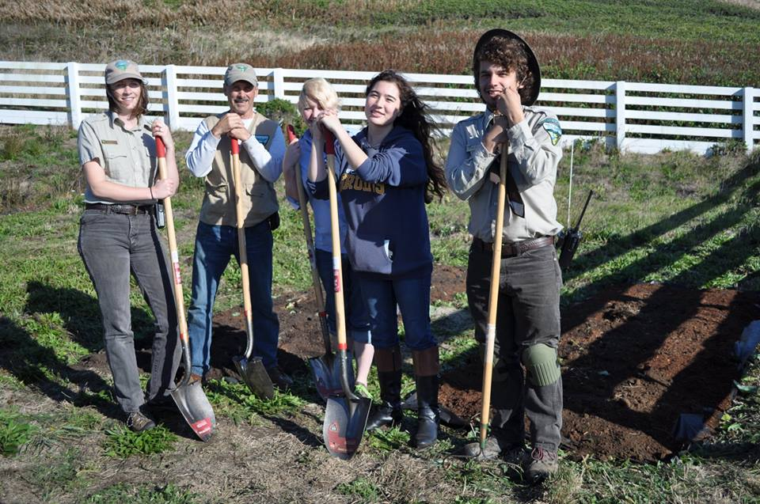
Lessons Learned
So What Went Wrong?

Slide 9
What is ECCO?
Engagement
Centered
Community
Organization
Alignment Research +
Issue Identification +
Naming & Framing
=

Slide 10
Alignment Research
What is Alignment Research and why is it important?
Aim High
Locate
Initiate
Get to know
Negotiate
Motivations
Encourage
Never Lie
Trust
Resilient
Empathetic
Self-confident
Energy-positive
Approachable
Risk taker
Creative
Honors Commitments
+

Slide 11
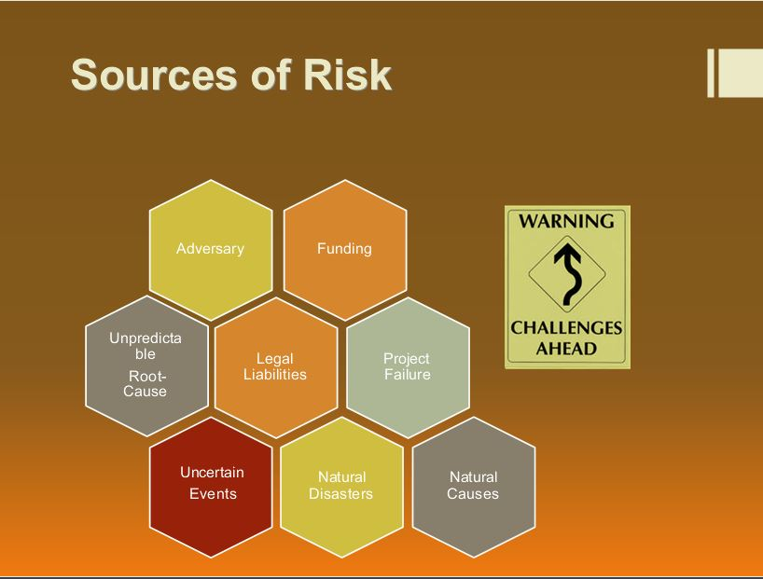
Mitigation Challenges
?

Slide 12
Issue Identification
What is Issue Identification and why is it important?
Statutory Authority
Mutual Goals and Objectives
Overarching Issue(s)
Risk Management Process
Notes:
Federal, state, local, and tribal governments have different goals and objectives than those of commercial, non-profit, educational, scientific, and other non-governmental organizations. In addition, many government agencies have legal constraints and statutory authorities that limit the size and scope of what they can and cannot do. The process of first identifying the overarching issue is mandatory to ensure compliance with applicable statutes and mandates. I will discuss this process further in subsequent sections of this report.

Slide 13
Naming and Framing
What is Naming and Framing and why is it important?
Framework for Decision Making
Naming
Defining a Problem
Deliberation
=
Framing
Asking Questions
Identifying Actions
Centered Concern

Slide 14
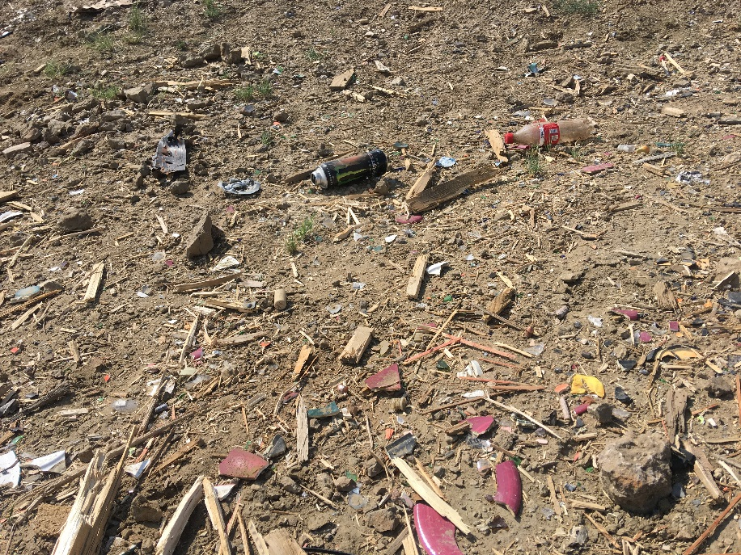
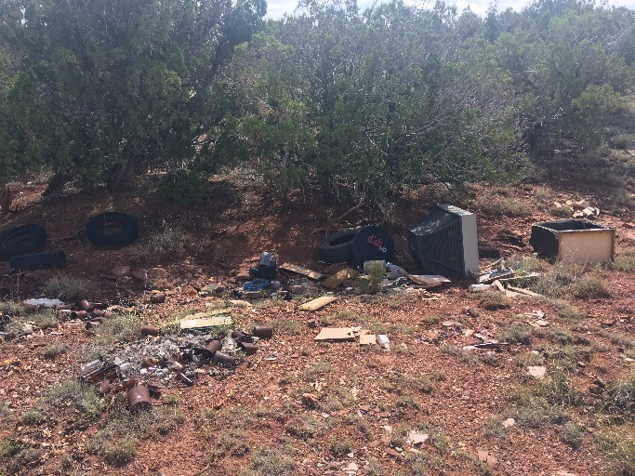
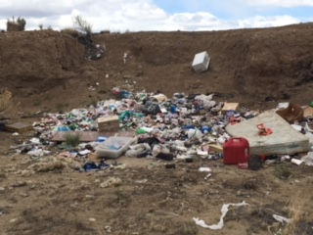
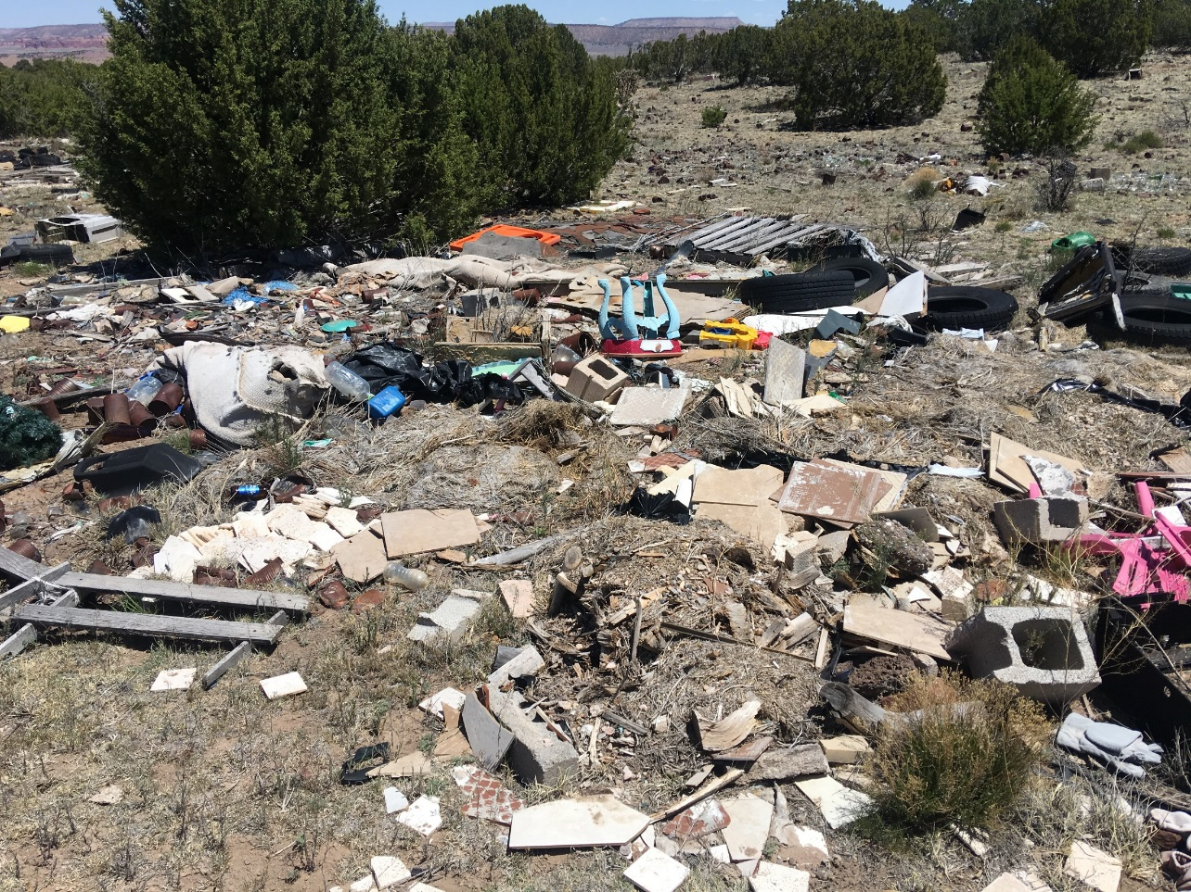
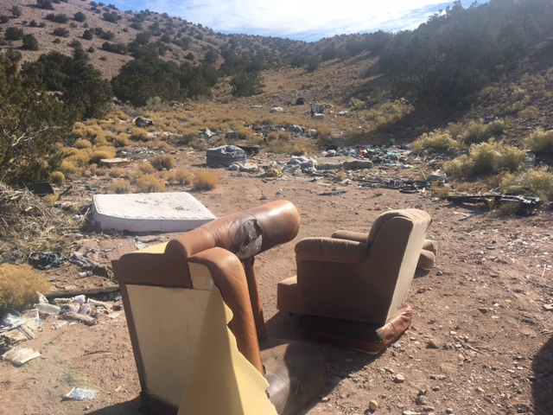
“Wicked” Problem of Illegal Dumping
Las Milpas, NM
Bluewater, NM
Mesa Chijuilla, NM
Placitas, NM
Prewitt, NM

Slide 15
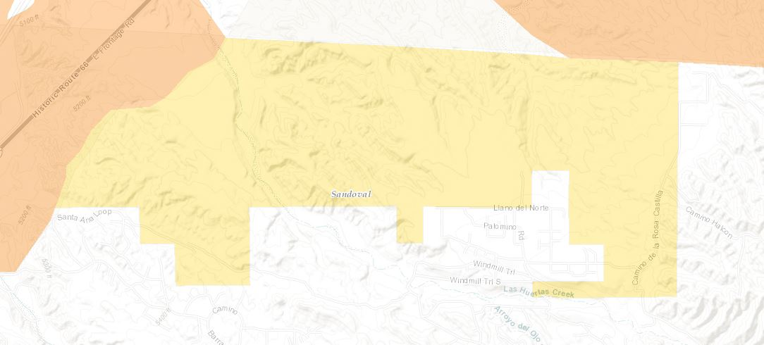
“Wicked” Problem of Illegal Dumping
Placitas, NM

Slide 16
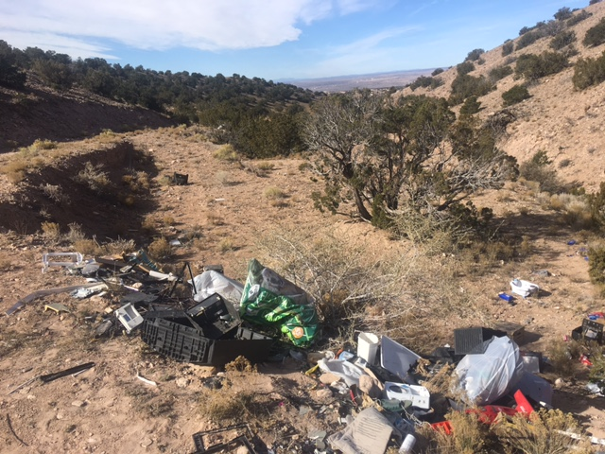
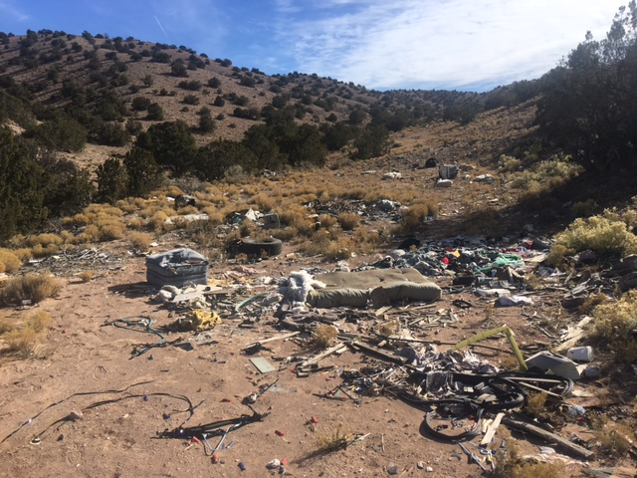
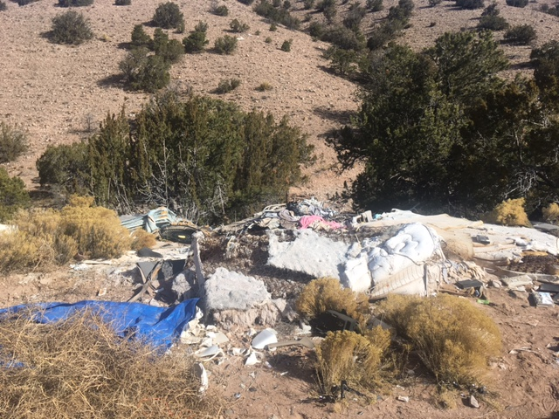
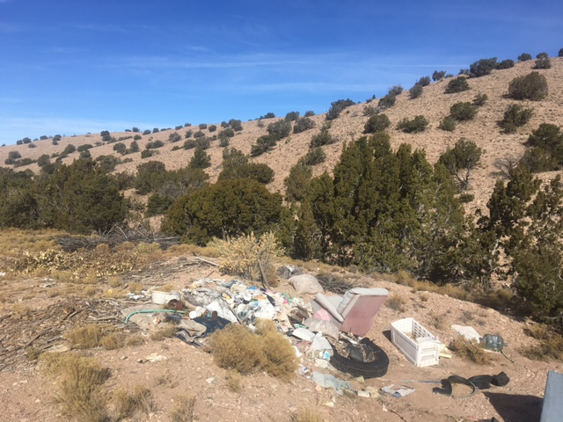
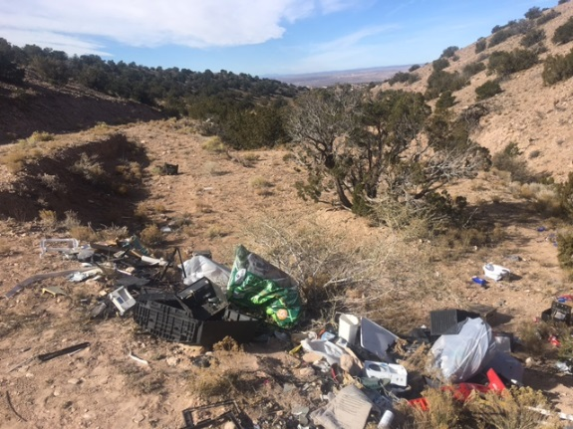
“Wicked” Problem of Illegal Dumping
Wild Spaces
Placitas, NM

Slide 17
“Wicked” Problem of Illegal Dumping
Placitas, NM

Slide 18
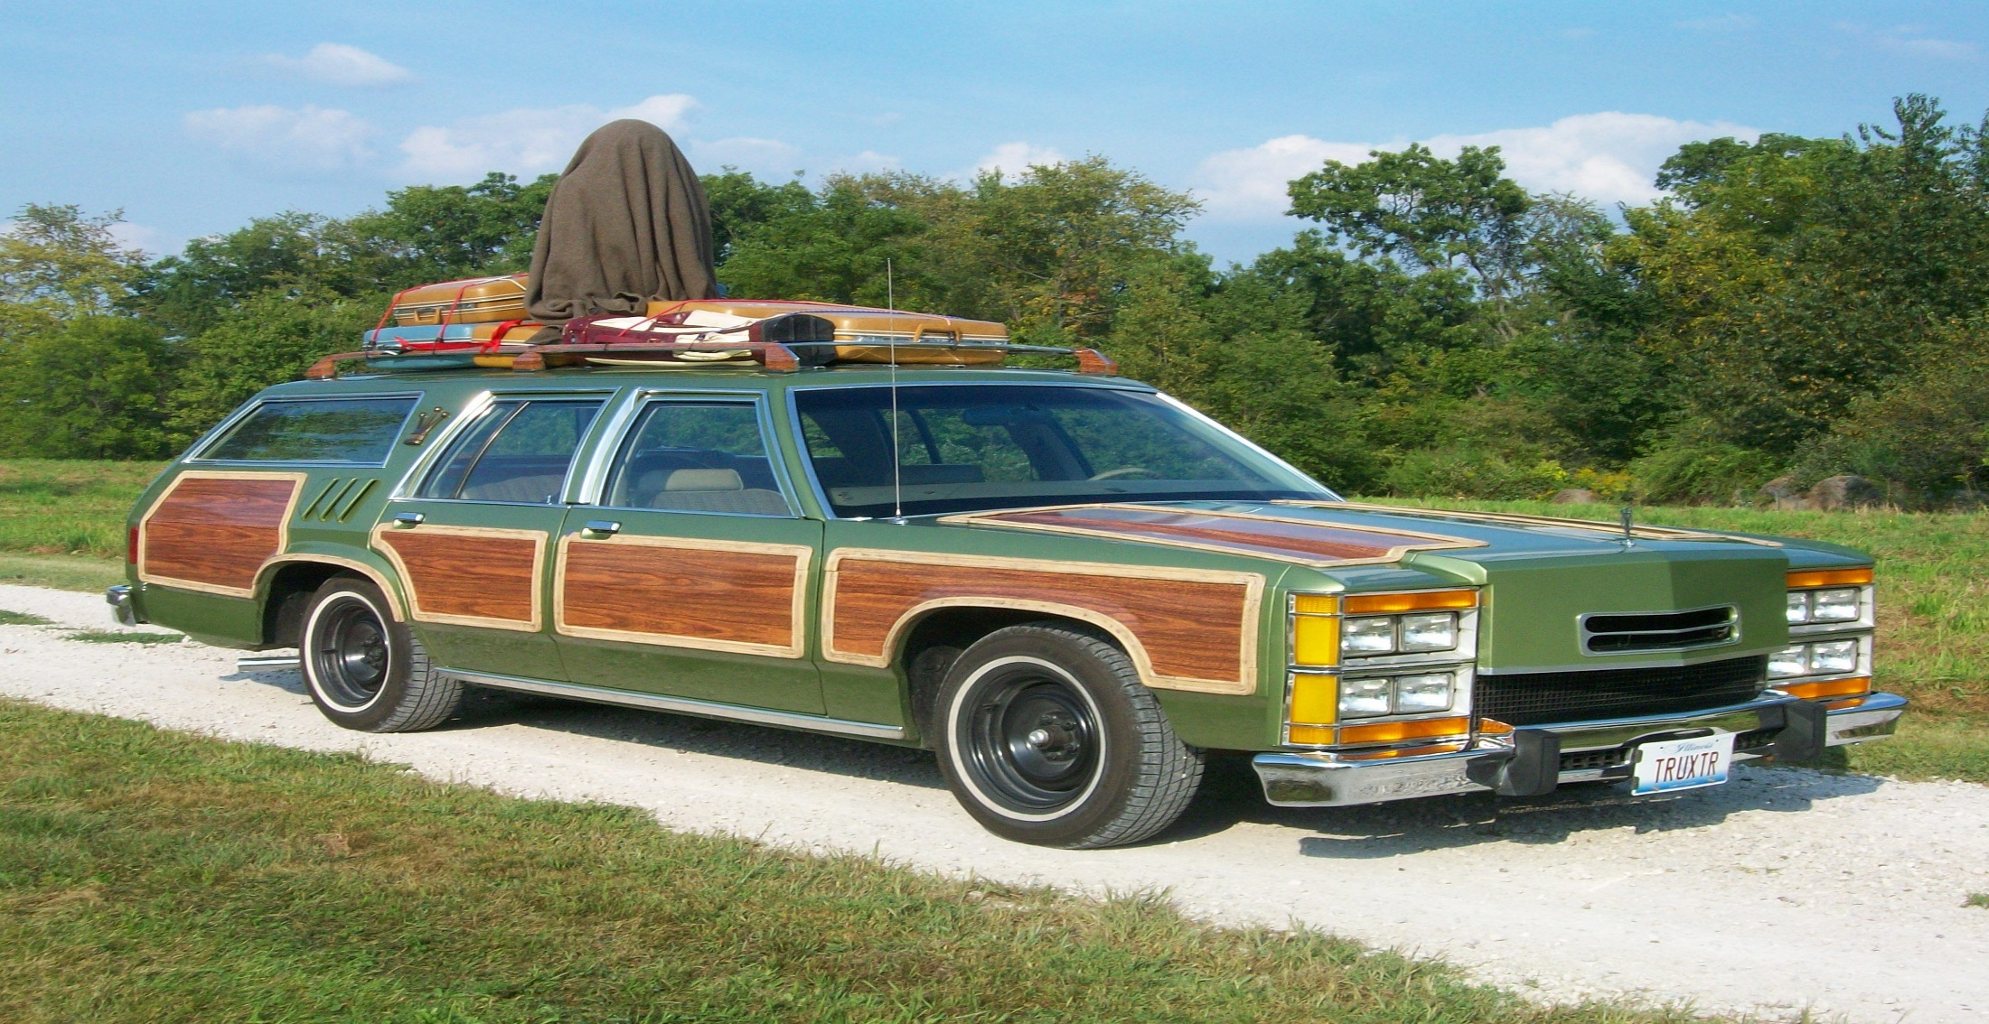
“Wicked” Problem of Illegal Dumping
Raims, Harold (Director), Simmons, Matty (Producer). (1983). National Lampoon’s Vacation [Image]. United States: Warner Bros.
Start like this..

Slide 19
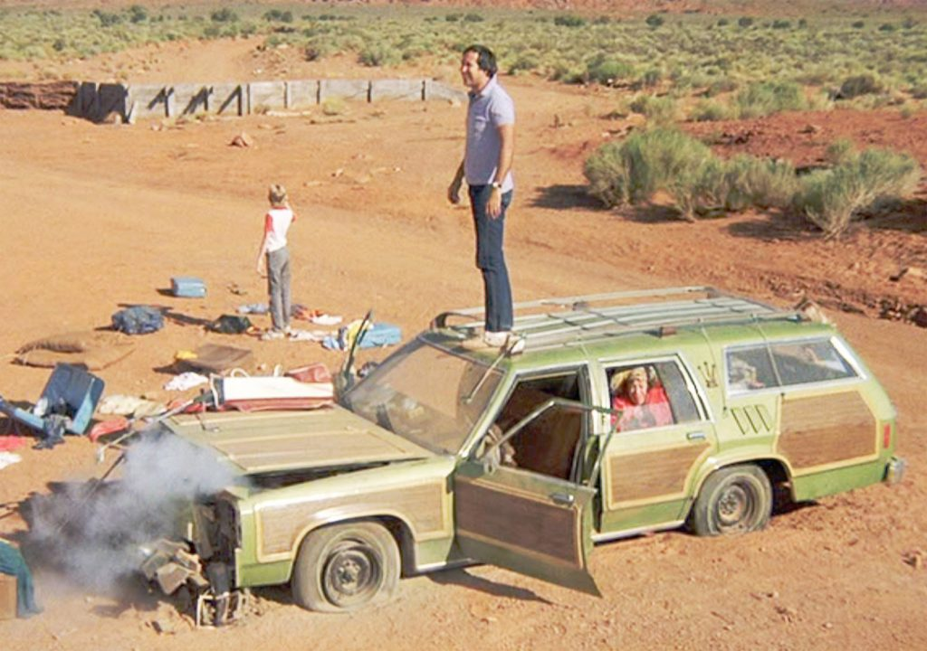
“Wicked” Problem of Illegal Dumping
Raims, Harold (Director), Simmons, Matty (Producer). (1983). National Lampoon’s Vacation [Image]. United States: Warner Bros.
Misfortune Happens

Slide 20
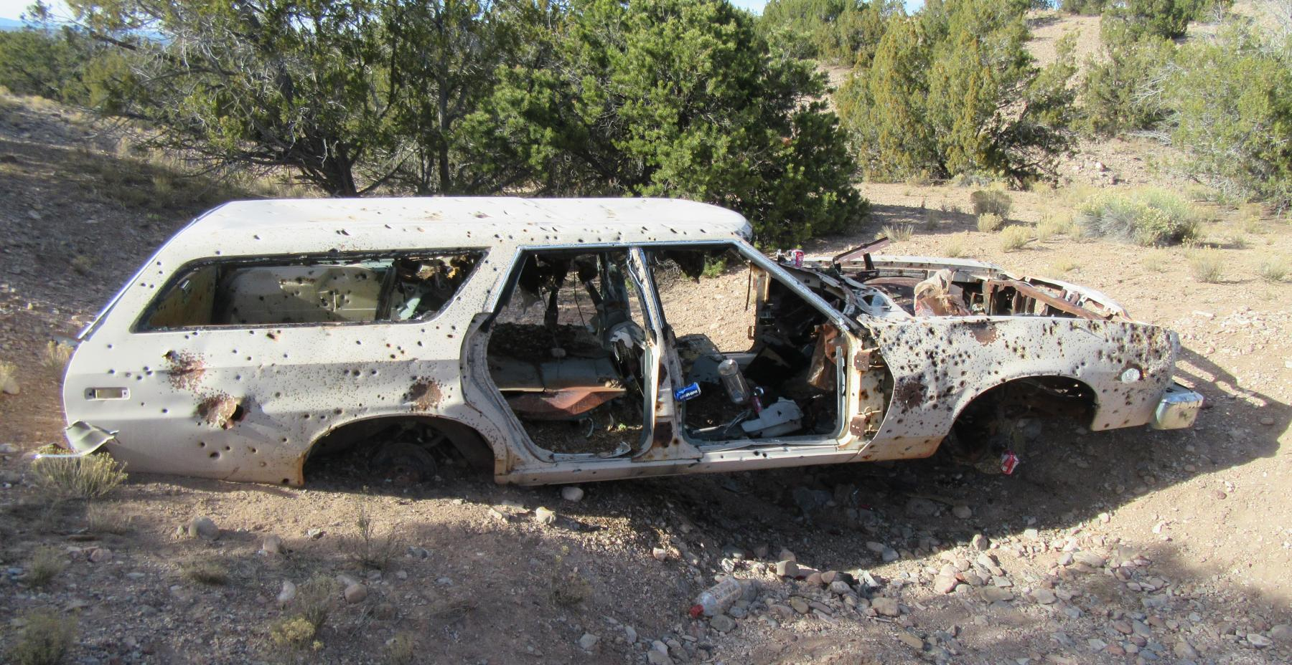
“Wicked” Problem of Illegal Dumping
Placitas, NM

Slide 21
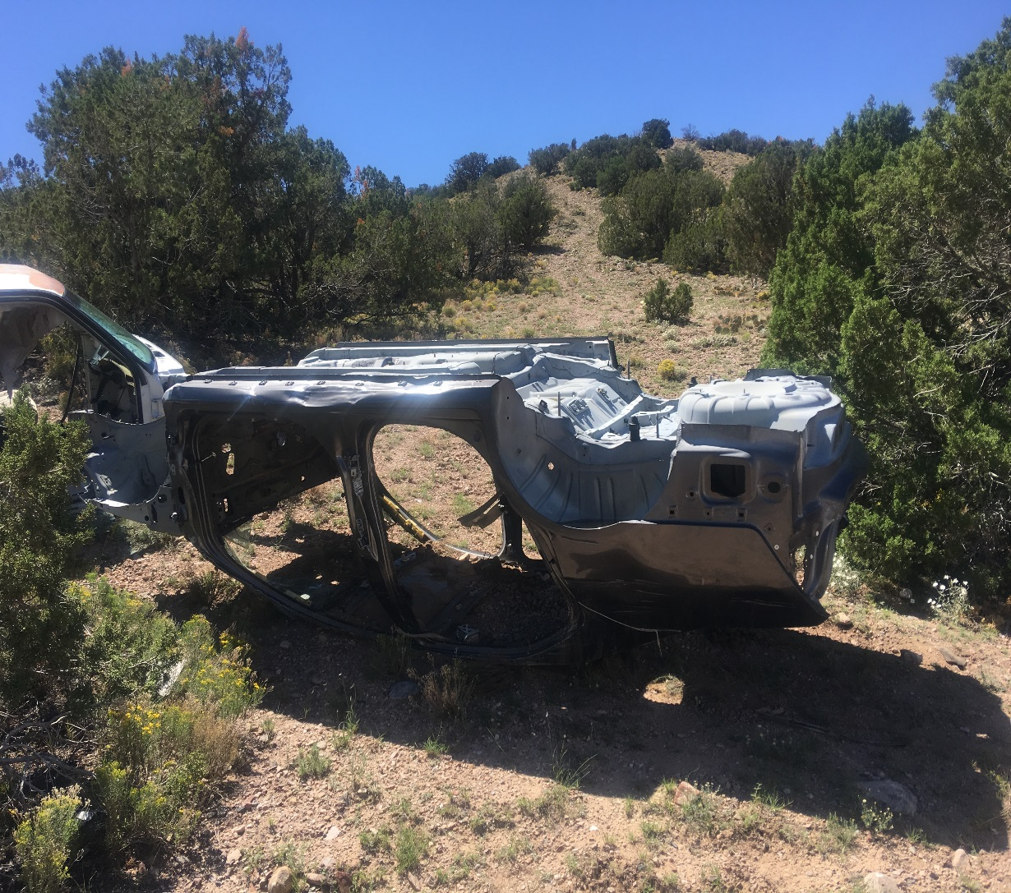
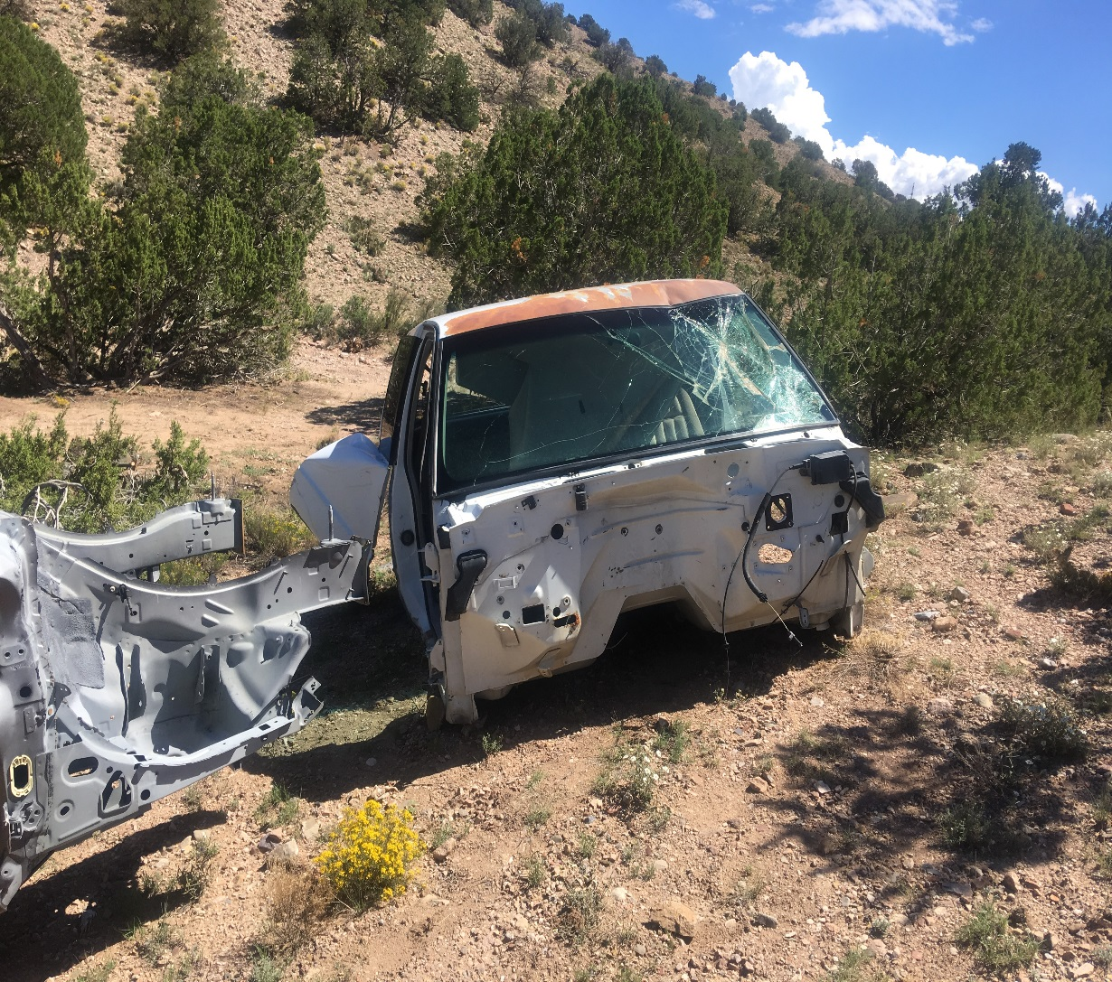
“Wicked” Problem of Illegal Dumping
Placitas, NM

Slide 22
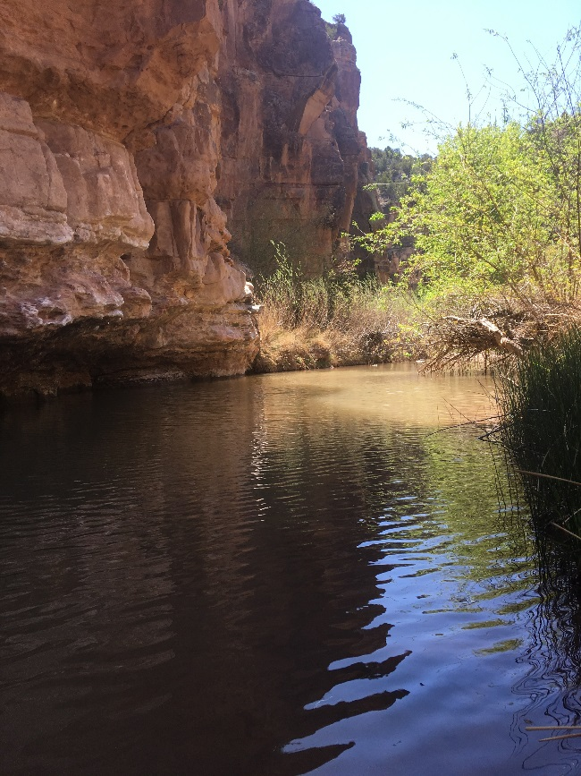
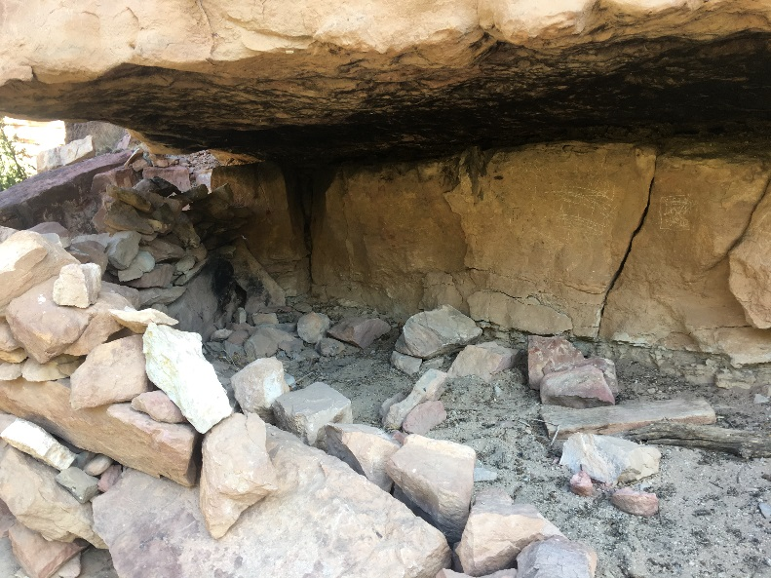
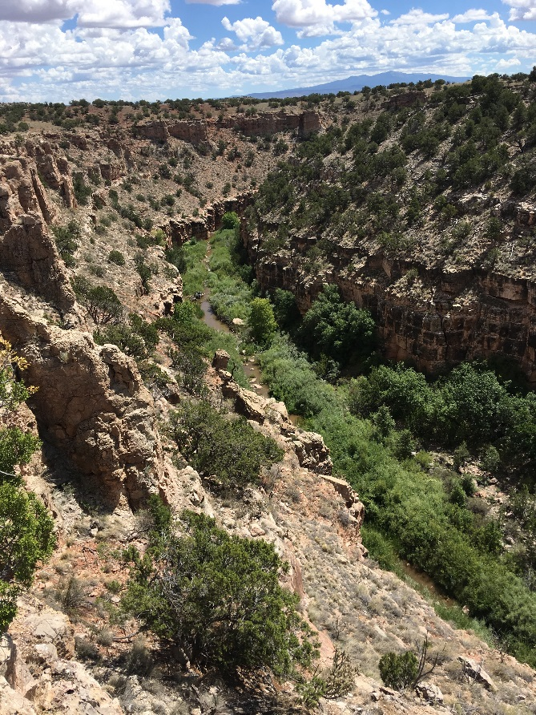
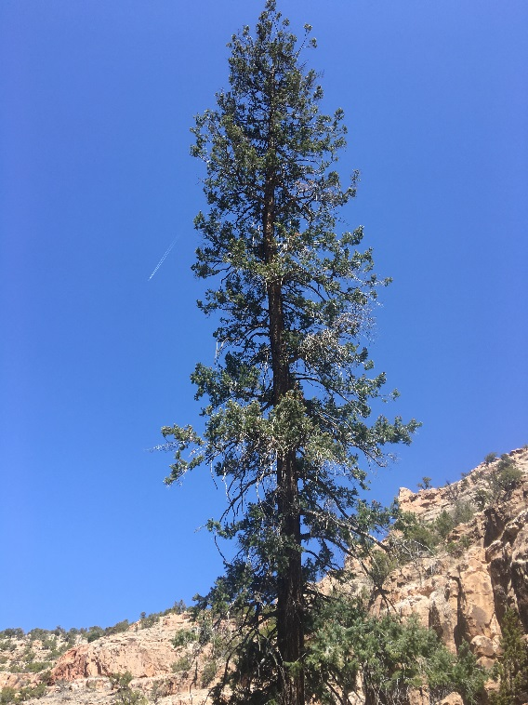
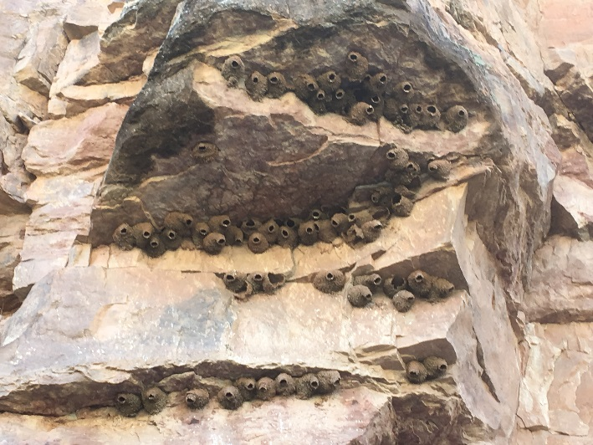
Cibola County- Bluewater Creek ACEC

Slide 23
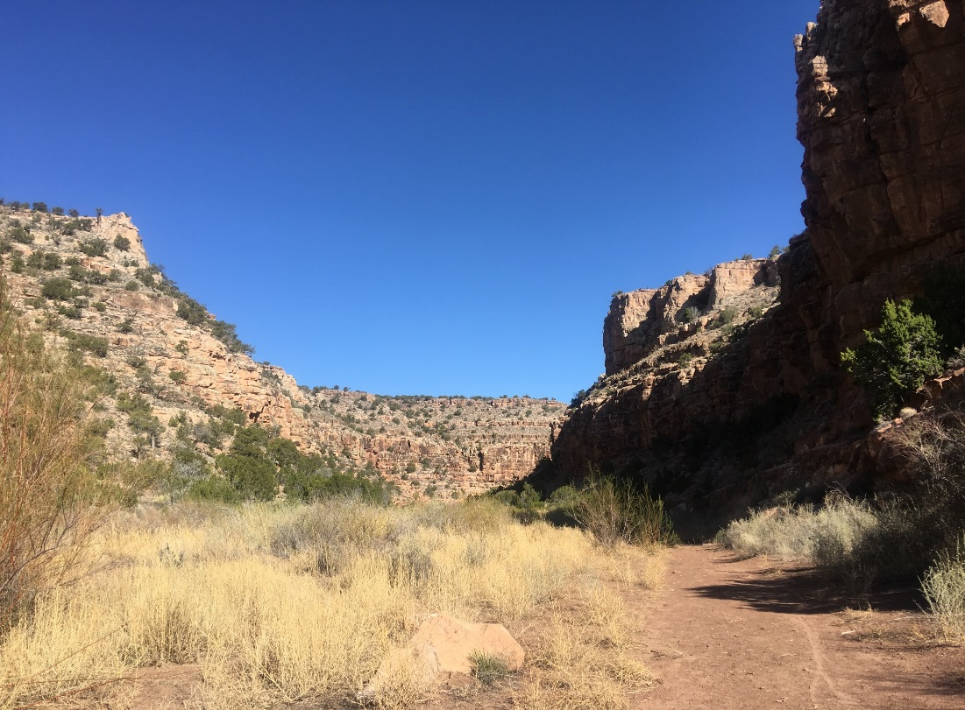
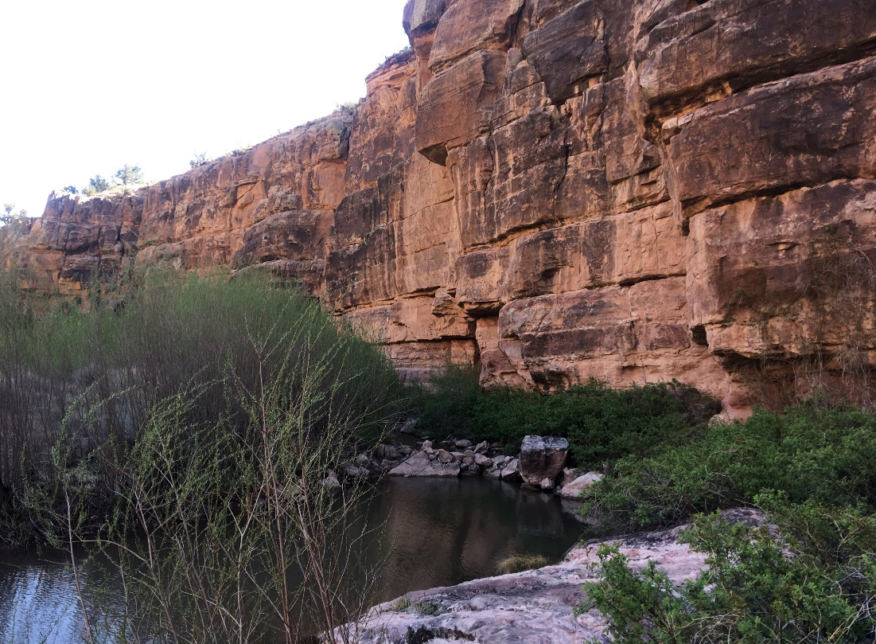
“Wicked” Problem of Illegal Dumping
Through the canyon and around the bend you will find the elusive…

Slide 24
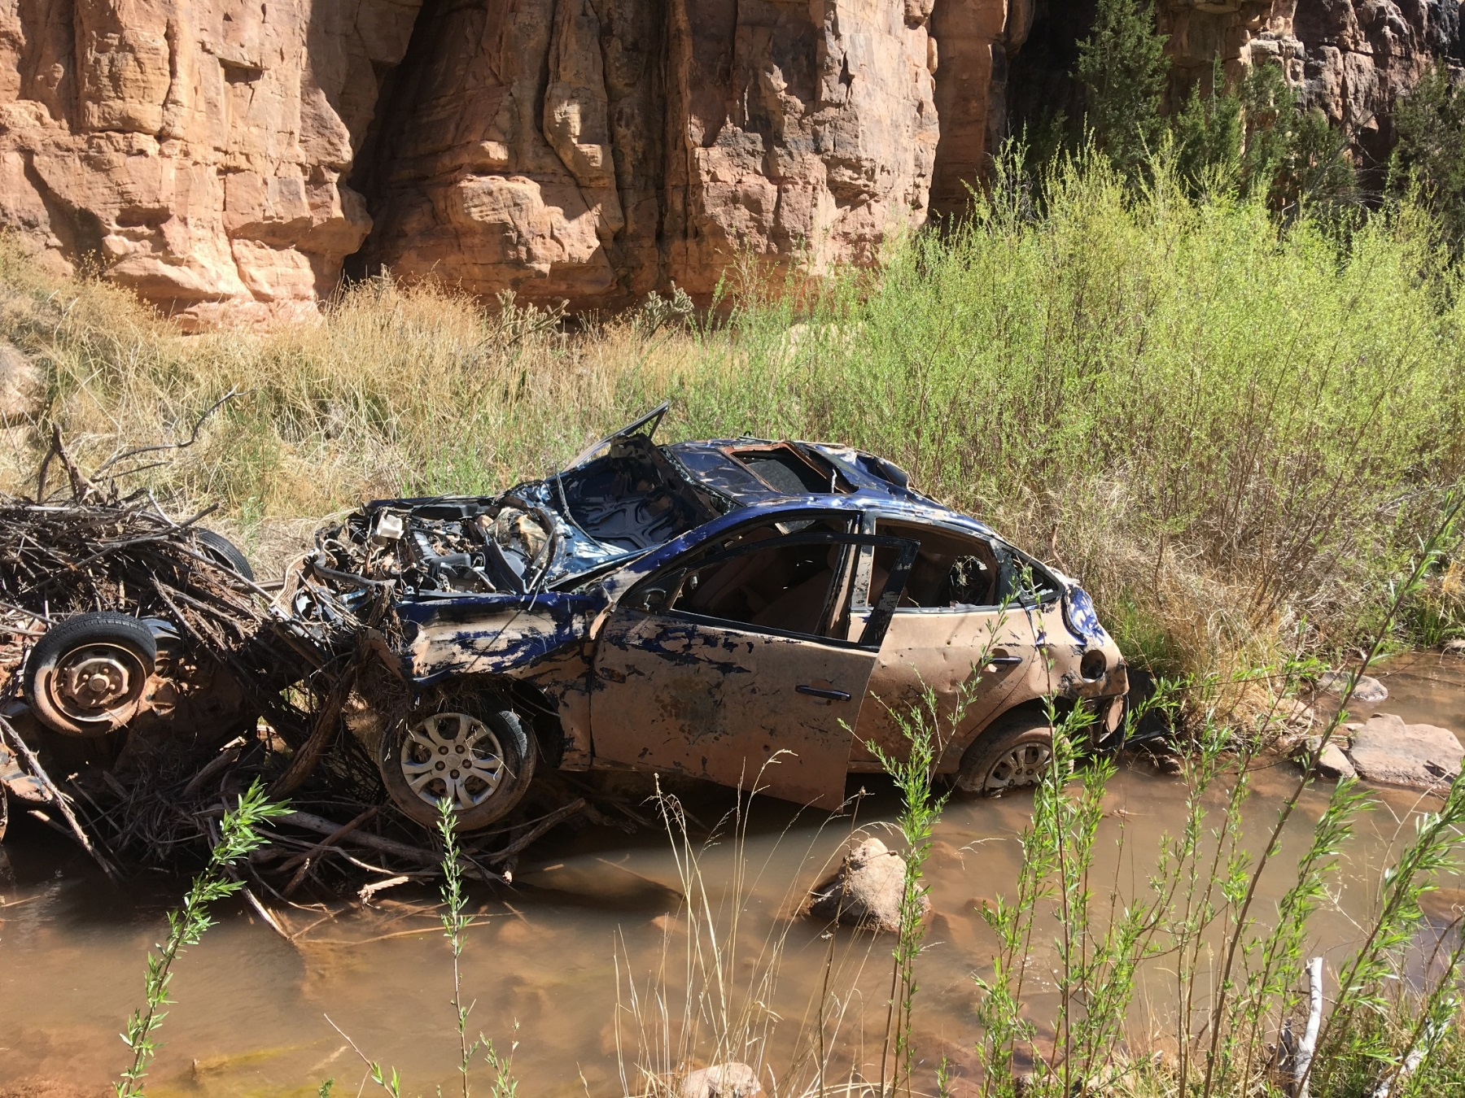
“Wicked” Problem of Illegal Dumping
Bluewater Creek ACEC, NM

Slide 25
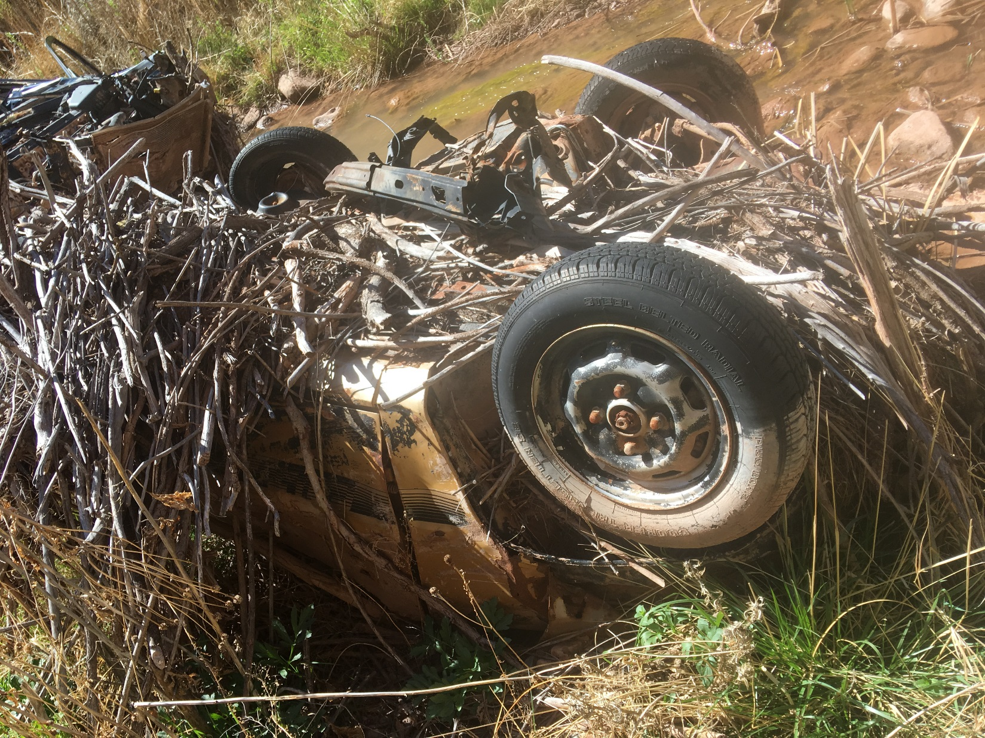
“Wicked” Problem of Illegal Dumping
Bluewater Creek ACEC, NM

Slide 26
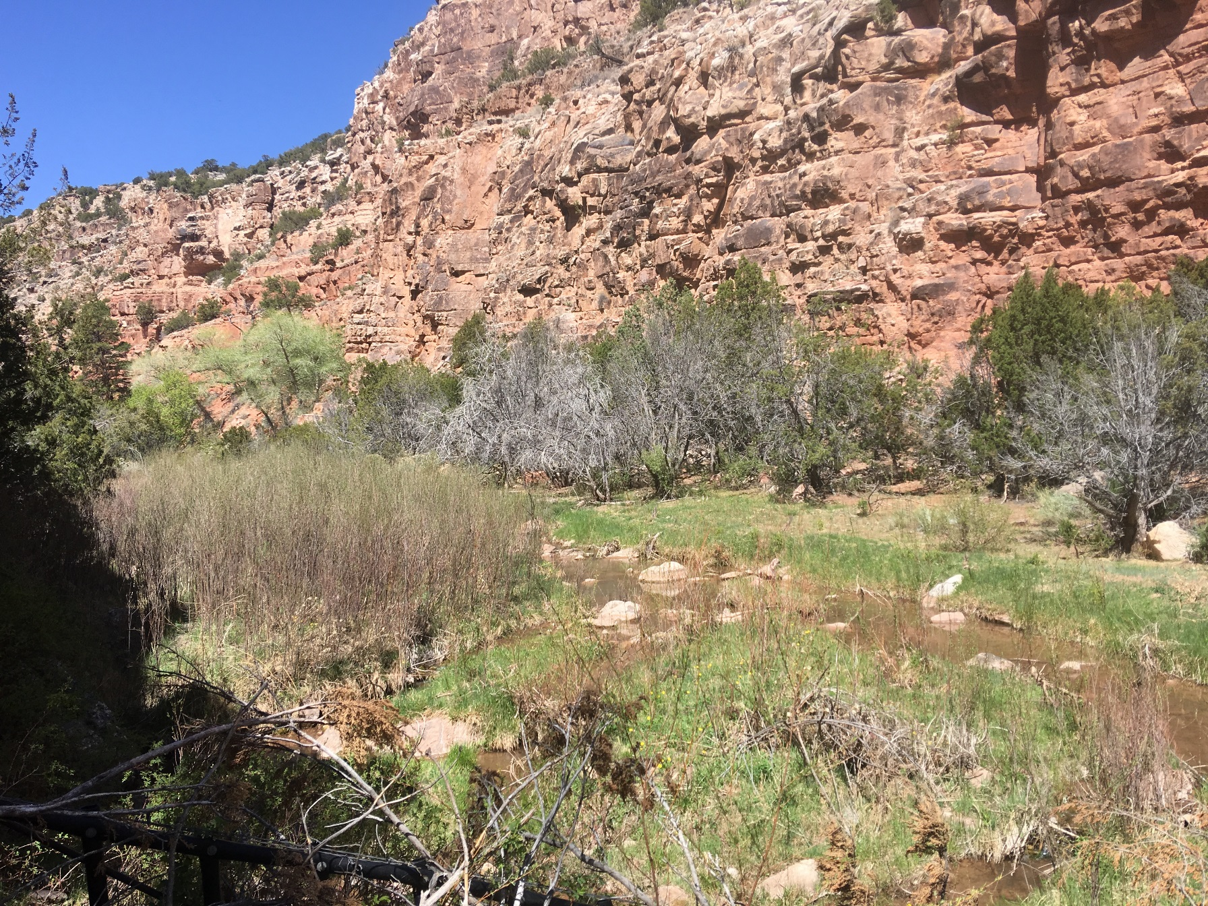
“Wicked” Problem of Illegal Dumping
Bluewater Creek ACEC, NM

Slide 27
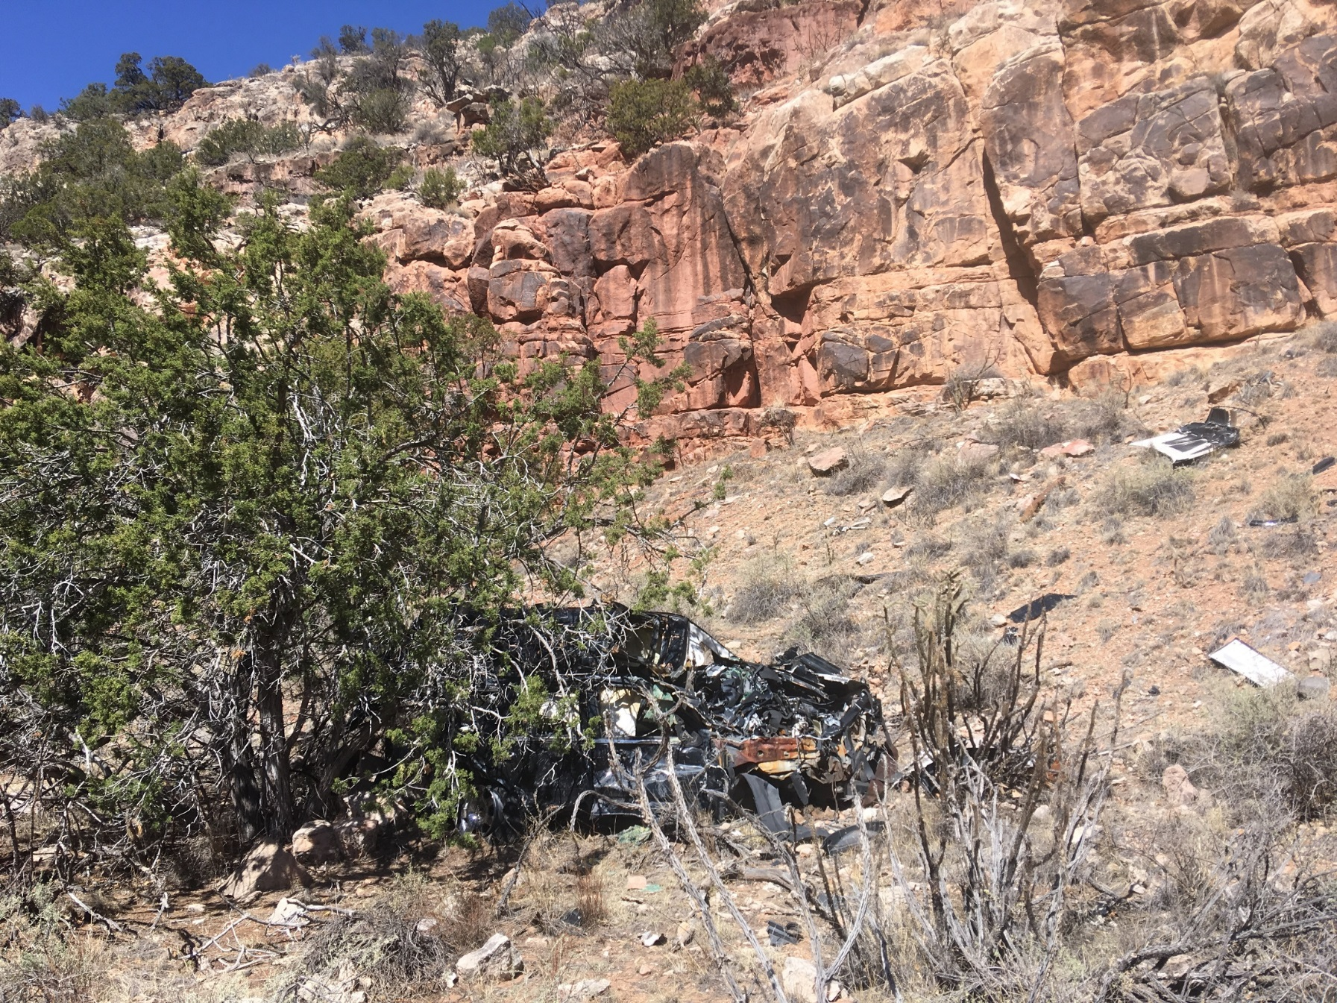
“Wicked” Problem of Illegal Dumping
Bluewater Creek ACEC, NM

Slide 28
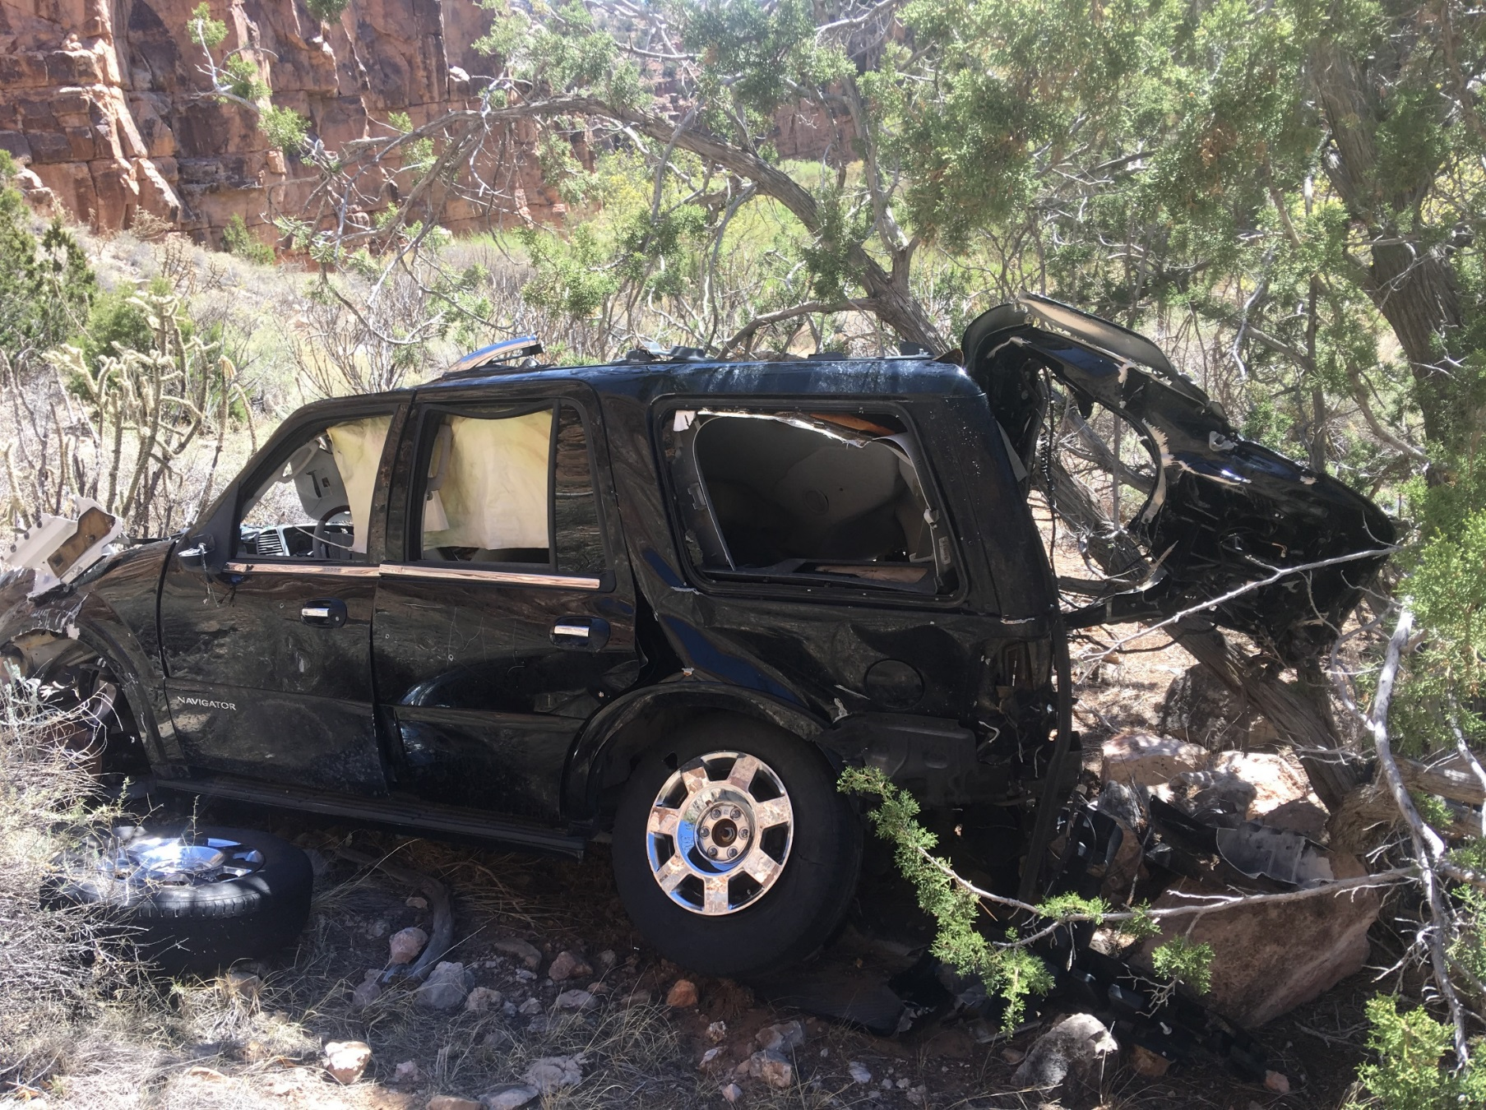
“Wicked” Problem of Illegal Dumping
Bluewater Creek ACEC, NM

Slide 29
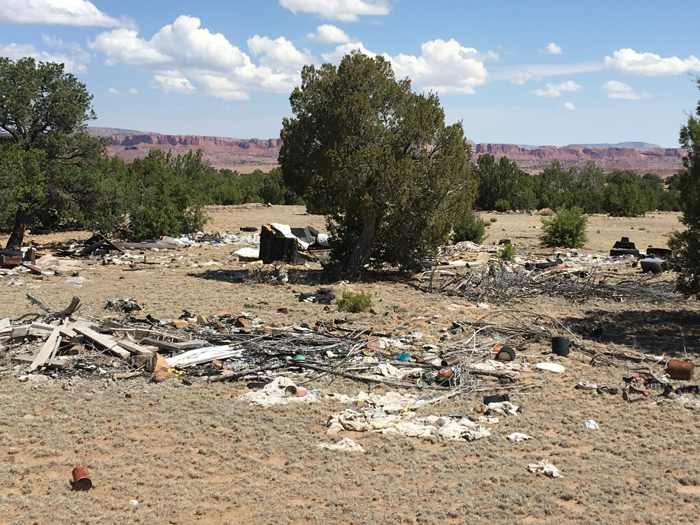
McKinley County- Prewitt, NM
Picturesque Landscapes

Slide 30
McKinley County- Prewitt, NM

Slide 31
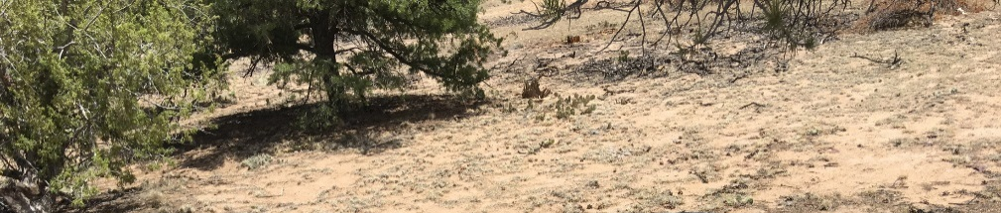
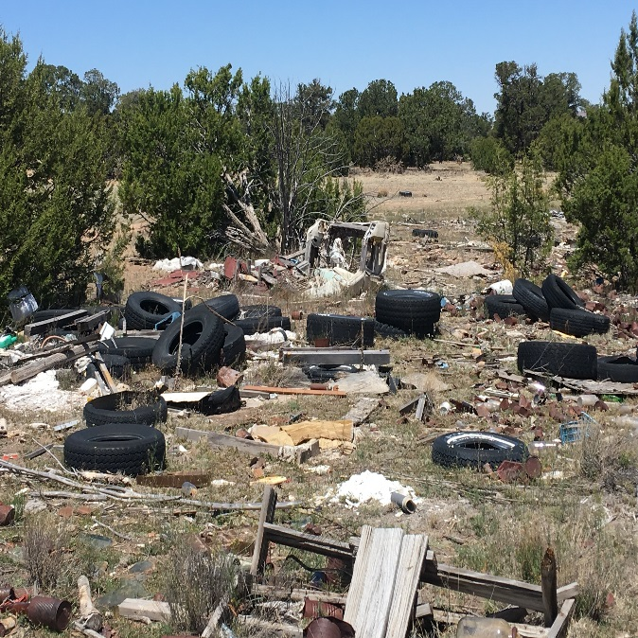
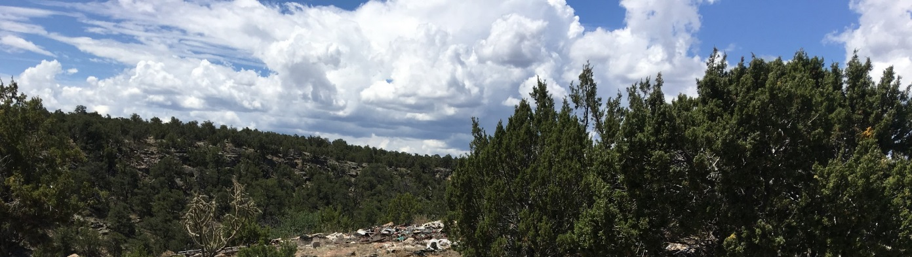
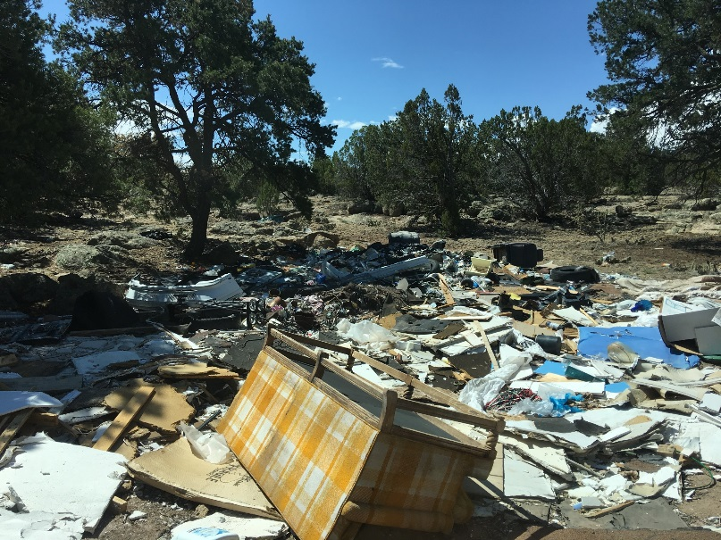
McKinley County- Prewitt, NM
Majestic Beauty?
Prewitt, NM

Slide 32

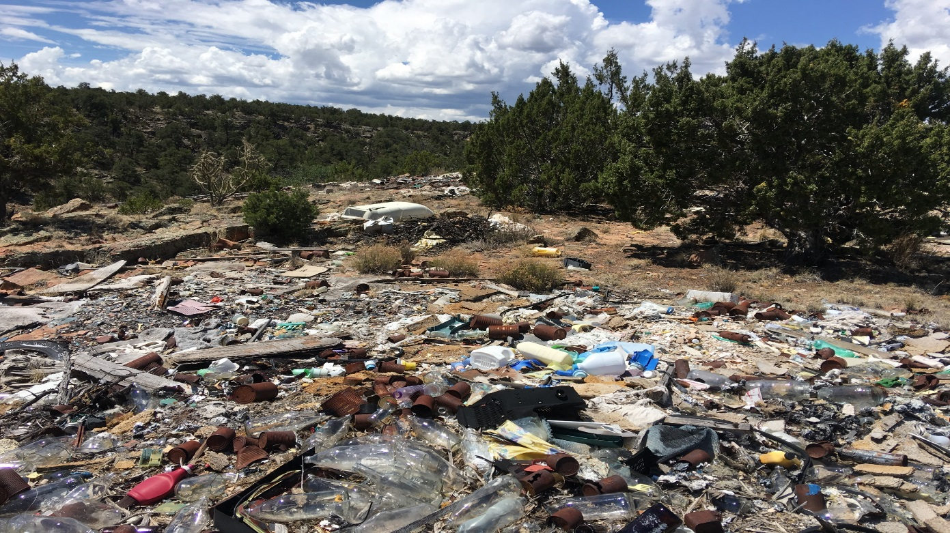
McKinley County- Prewitt, NM

Slide 33
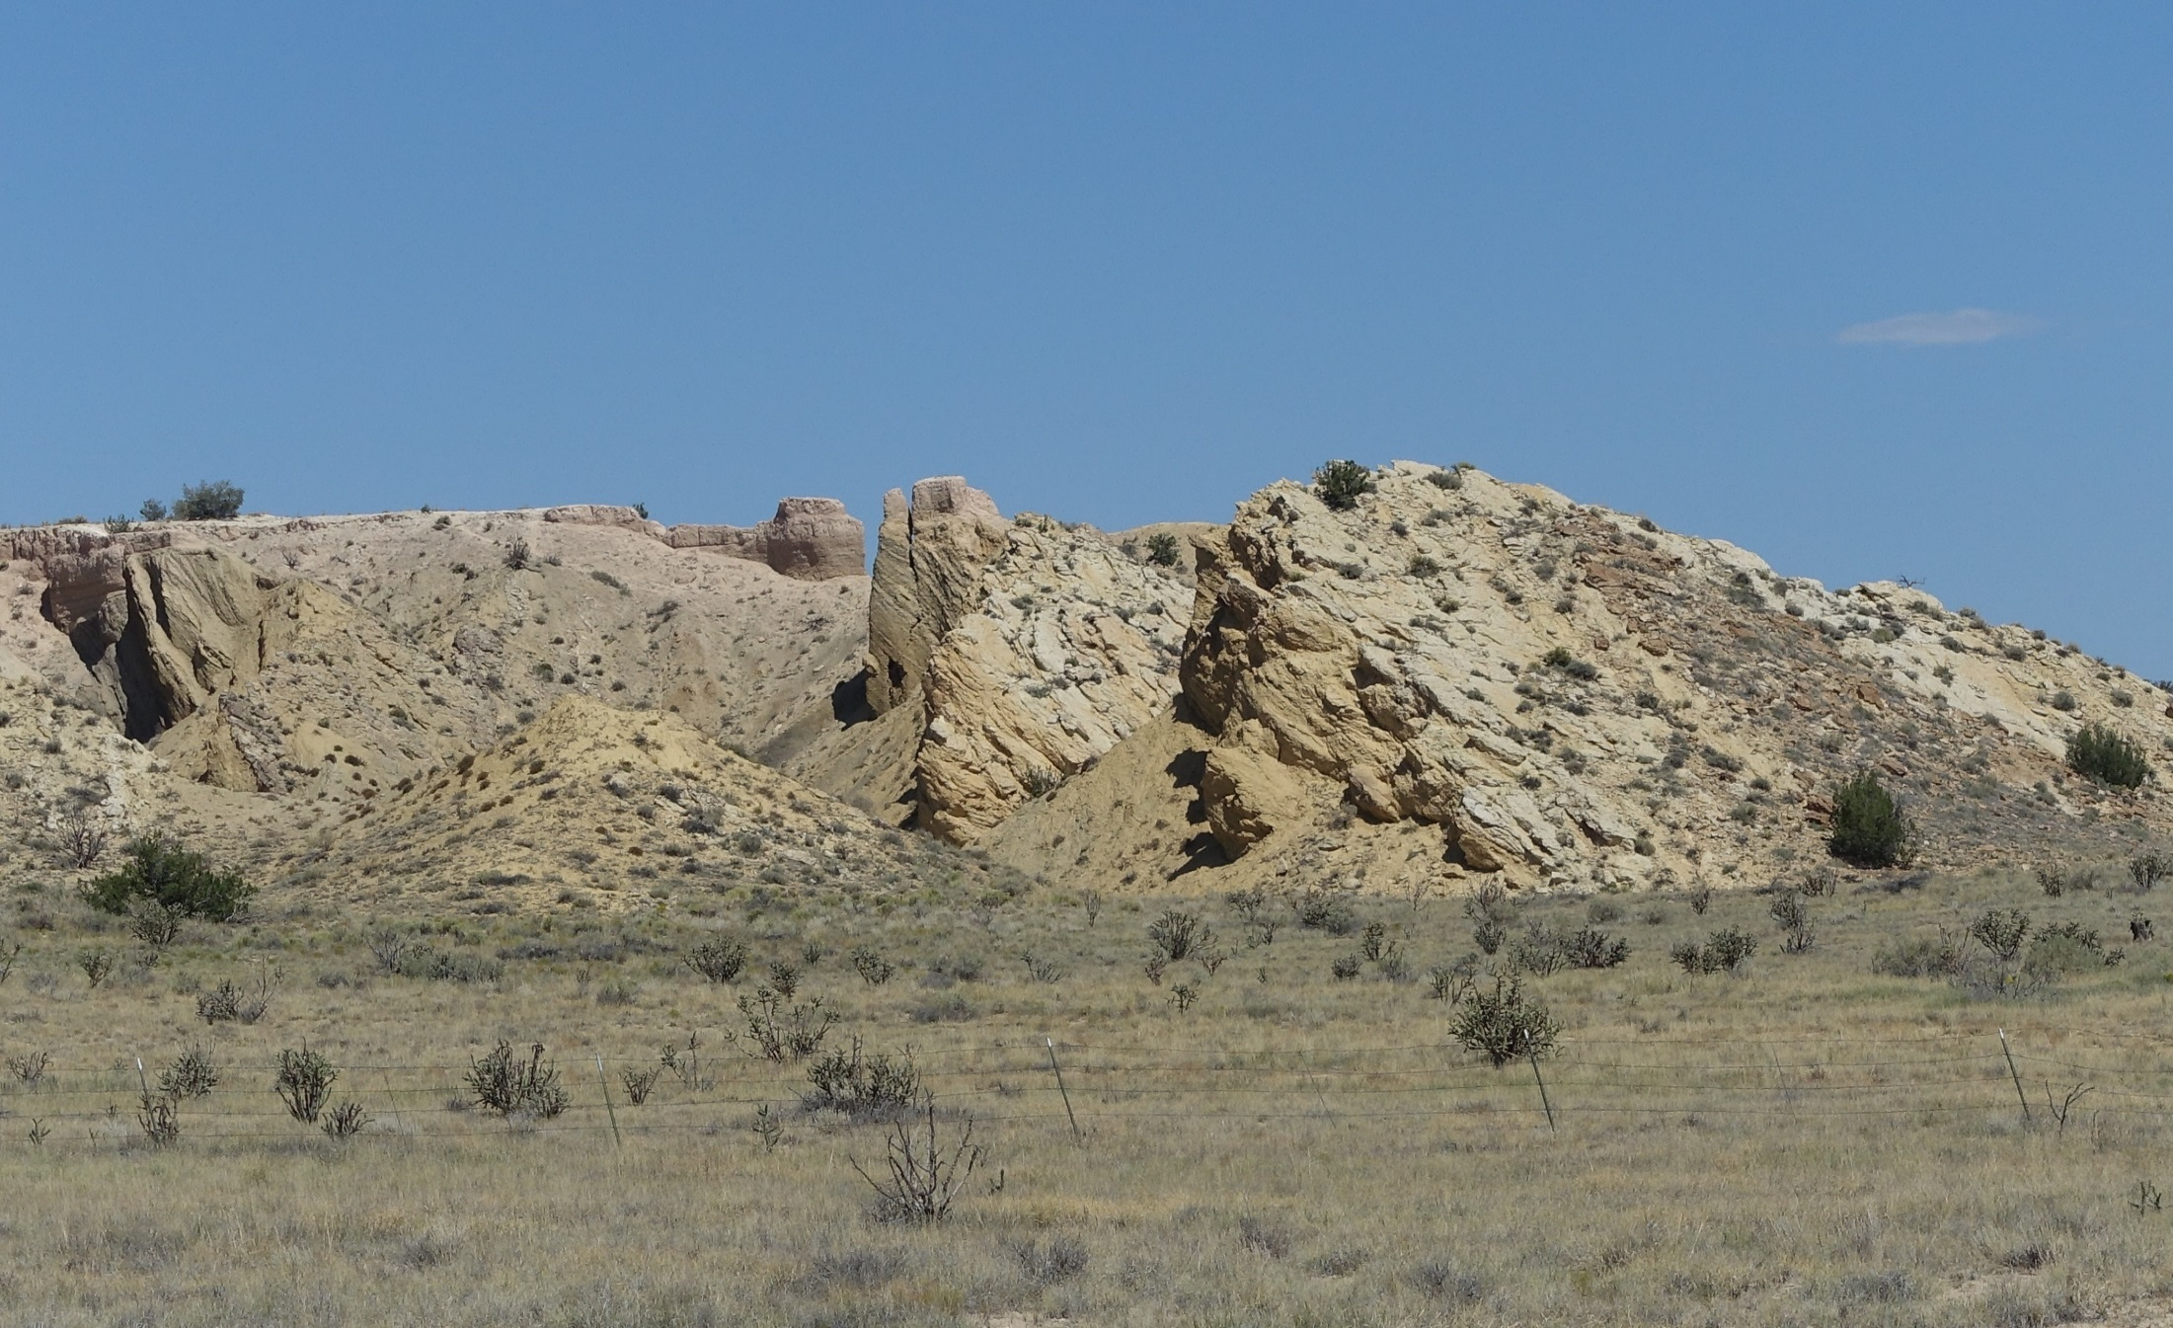
Sandoval County- BLM and Zia Recreation Lands
Affected Areas of Joint Interest
Zia Recreation Trust Lands
White Ridge Bike Trails Area
Las Milpas
Ojito Wilderness

Slide 34
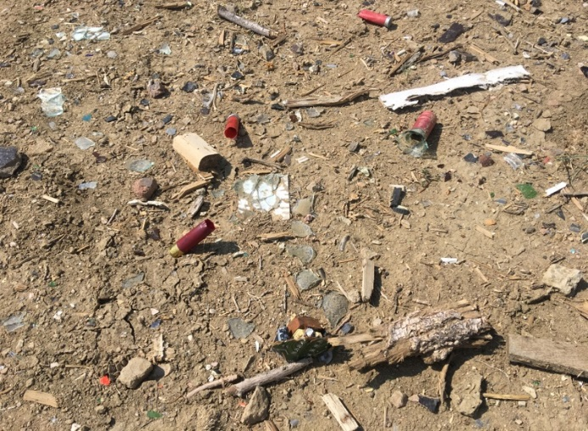
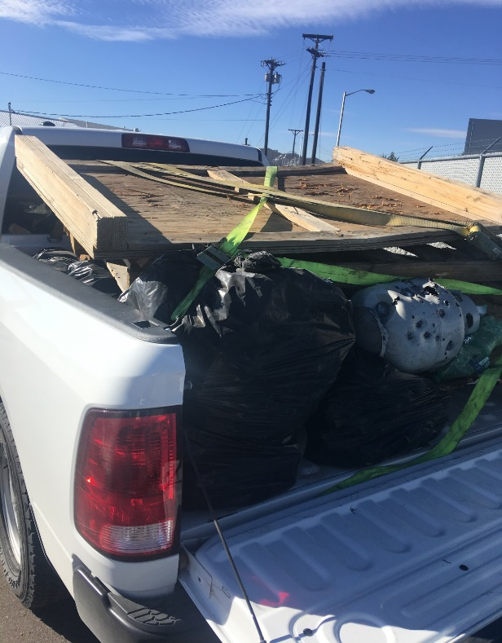

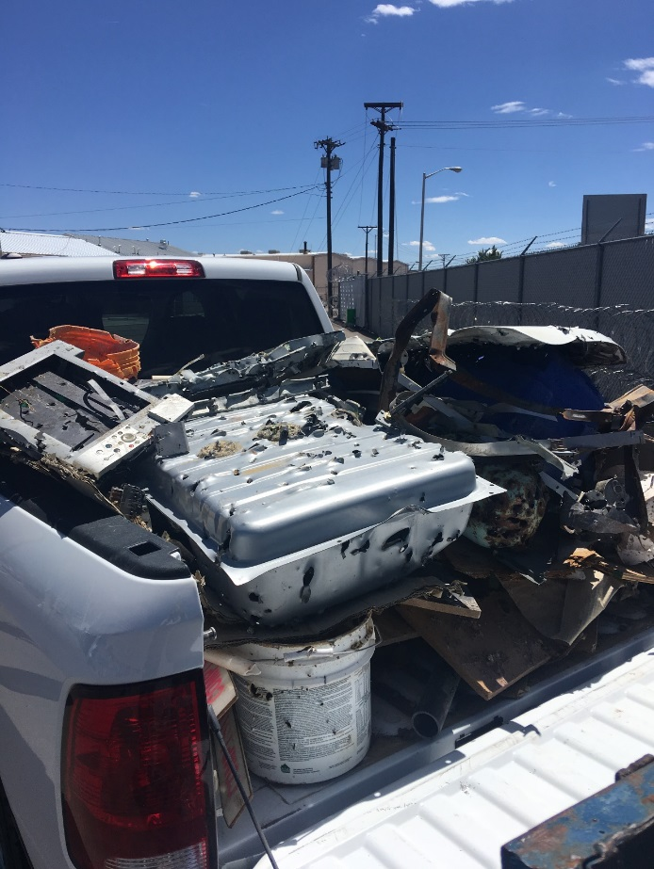
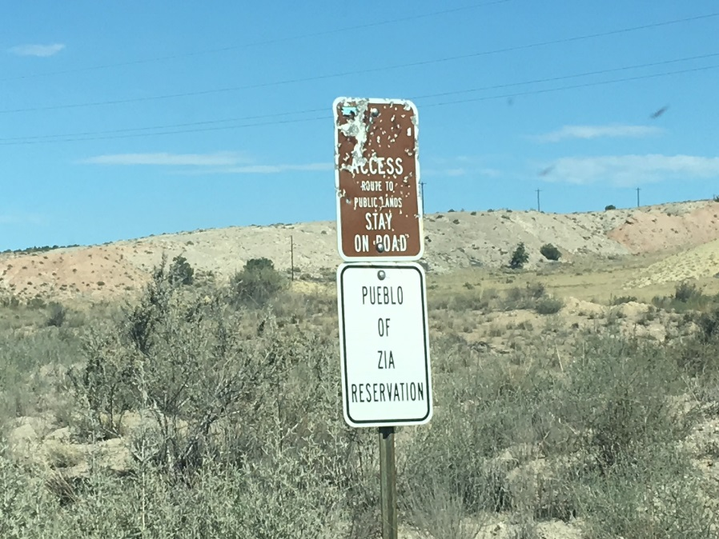
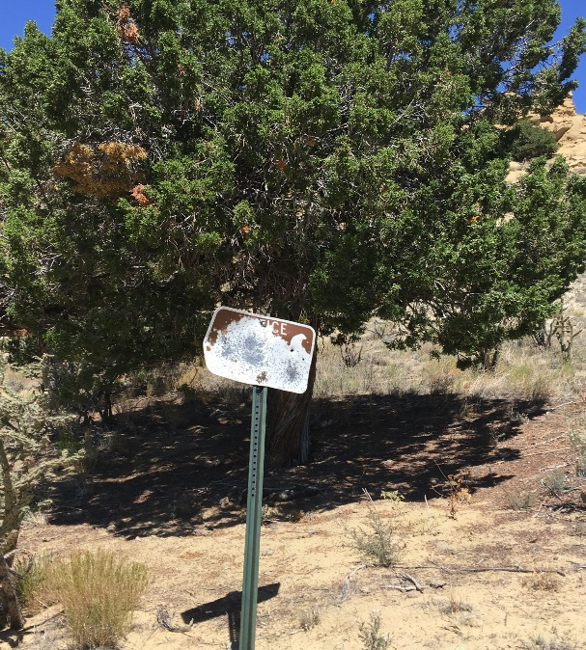
Sandoval County- Zia & BLM Recreation Lands
Aftermath of Recreational Shooting

Slide 35
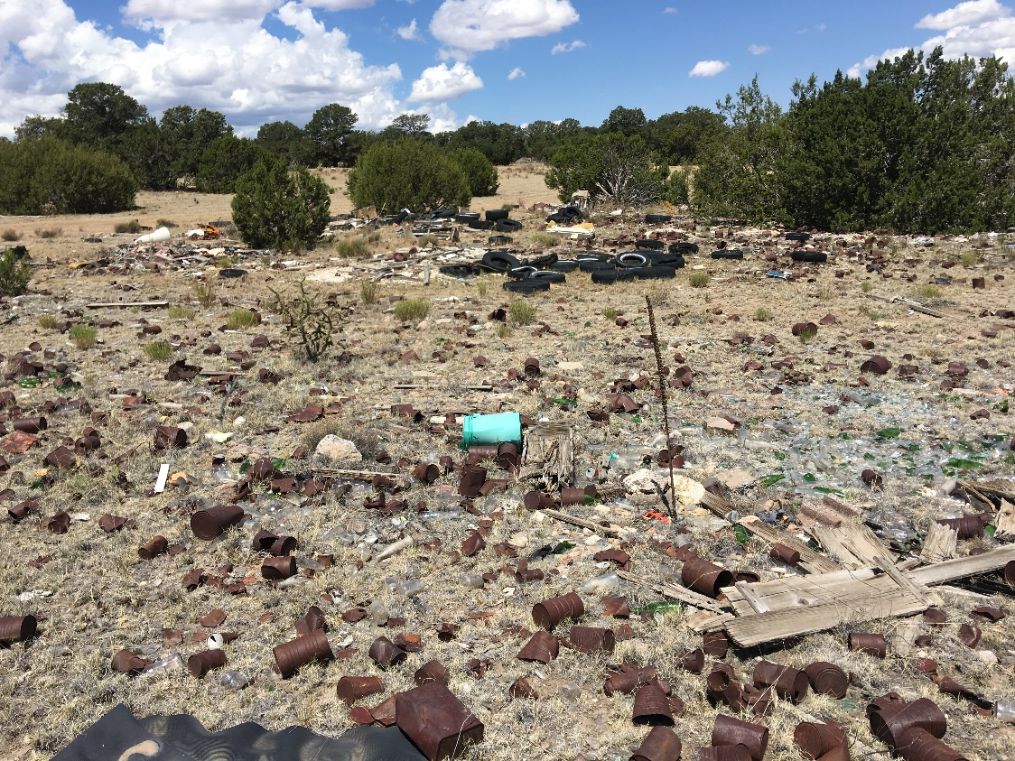
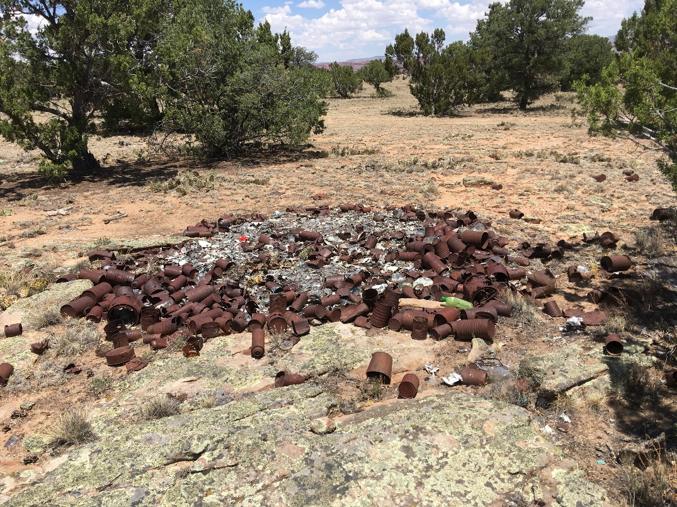
Mitigation Challenges- Statutes
Historic Properties?
NHPA?

Slide 36


Mitigation Challenges
Equipment
&
Labor Costs

Slide 37





Challenges- Due Process

Slide 38
Mitigation Challenges- Due Process- NEPA
NEPA- Proposal
Potential Effects?
EIS
EA
CE/CX
DNA
Removal and Disposal of Materials of No Historical Value: H-1790-1, Appendix 4: J10: “Removal of structures and materials of no historical value, such as abandoned automobiles, fences, and buildings, including those built in trespass and reclamation of the site when little or no surface disturbance is involved.”

Slide 39
ECCO in the RPFO
Short-Term Accomplishments of
ECCO
March 2017-Present

Slide 40

ECCO in the RPFO
Naming and Framing
Culture
Education
Hours of operation
Days of the week
Distance
Cost
Capabilities
Access

Slide 41







What ECCO Has Accomplished
Debris Removal
446,000 lbs. of debris
5,600 lbs. of tires
11 sites funded for reclamation
Notes:
446,000 lbs of trash = 360 cubic yards of debris
20 cubic yards of tires
NEPA Decision Records rendered -4
Communities-sites positively affected=

Slide 42



What ECCO Has Accomplished
Community Engagement
70 volunteers engaged
425 volunteer hours
10 RYMC youth engaged
415 youth hours worked
Notes:
Residential and construction debris removed
Tires

Slide 43





What ECCO Has Accomplished
Leveraged Funding
$51,524 received for reclamation contract
$9,804 in volunteer labor donated
$3,780 in equipment donated
$2500 donated for curriculum development
$1,092 in misc. supplies donated
Notes:
Diné Culture- Week 1
Diné Character Building- Week 2
NM Math Common core- Week 3
Next Generation Science- Week 4
Science-GIS Alternative- Week 4
New Mexico Art Standards- Weeks 5 & 6

Slide 44
ECCO in the RPFO
Long-Term Accomplishments of
ECCO
March 2017-?

Slide 45

What ECCO Has Accomplished
Education
Interdisciplinary Curriculum on Preventing Illegal Trash Dumping
Notes:
Diné Culture- Week 1
Diné Character Building- Week 2
NM Math Common core- Week 3
Next Generation Science- Week 4
Science-GIS Alternative- Week 4
New Mexico Art Standards- Weeks 5 & 6

Slide 46








What ECCO Has Accomplished
Partnerships
32 partnerships created
Notes:
Diné Culture- Week 1
Diné Character Building- Week 2
NM Math Common core- Week 3
Next Generation Science- Week 4
Science-GIS Alternative- Week 4
New Mexico Art Standards- Weeks 5 & 6

Slide 47

What ECCO Has Accomplished
Due Process Completed
4 NEPA Categorical Exclusions completed
4 Records of Decision rendered
6 Vehicles cleared for removal
1 Assistance Agreement funded

Slide 48




ECCO
Thank You!
Notes:
Diné Culture- Week 1
Diné Character Building- Week 2
NM Math Common core- Week 3
Next Generation Science- Week 4
Science-GIS Alternative- Week 4
New Mexico Art Standards- Weeks 5 & 6

